Slide 1



Why did you want to come to the session today?
Take some time to write this on the chart paper on the tables.

Slide 2
Getting Involved in Research
Dr Katey Collins
Dr Vikram Mohan
Dr Caroline Belchamber
Luisa Holt
Notes:
Top left clockwise – Southampton, Chichester, Brisbane, London, Oxford, University of wente.

Slide 3
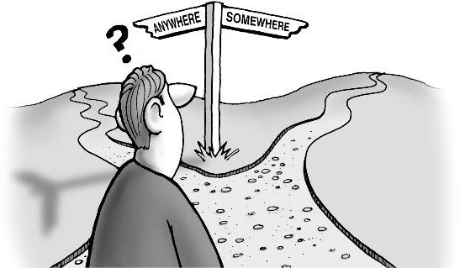
Plan
Summarise the differences between audit, service evaluation, quality improvement and research.
Identify ways to engage with research including:
  a project in practice
  a higher degree
  seeking external funding
  pursuing a clinical academic career
Identify advice and resources that are available to clinicians, when starting out in research.

Slide 4

Starting out- what is your goal?
What role do you aspire to in the future?

Slide 5
Understanding Service Improvement and Research

Slide 6
Starting out - what is your goal?
Clinical research delivery - NHS
  Working in the research delivery team
  Clinician Researcher Credentials Framework
  https://www.nihr.ac.uk/health-and-care-professionals/training/clinician-researcher-credentials-framework.htm
  Clinician Researchers – Principal Investigator or Local Lead Investigator
Clinical academic career pathways - University
  Higher degrees such as Masters, MD or PhD
  Chief Investigators – leading on research grants or proposals
    may start out as a co-applicant
Notes:
Our Clinician Researcher Credentials Framework provides masters level qualifications. Part-time courses in clinical research delivery:
Postgraduate Certificate
Postgraduate Diploma
Masters degree

Slide 7




Can you prove your clinical effectiveness?
Outcome measures
Audit
Patient feedback
Research
Service evaluations
Dissemination

Slide 8


Group Brainstorm: can you prove….
Successful clinical outcomes?
Positive patient experiences?
Staff consistently use evidence-based practice?
Notes:
Have chart paper and pens for groups to work together to identify ways to explore these questions

Slide 9
Key differences
Research | Service evaluation & QI | Audit
To generate new knowledge | To define or judge current care | To deliver best care
Addresses clearly defined questions, aims and objectives | Measures current service without reference to a standard | Measures against a standard
Usually involves collecting data additional to routine care | Usually involves analysis of existing data, but may include administration of interview or questionnaire | Usually involves analysis of existing data, but may include administration of interview or questionnaire
May involve randomisation | No randomisation | No randomisation
Normally requires Research Ethics Committee review | Does not require Research Ethics Committee review | Does not require Research Ethics Committee review
After HRA, 2016

Slide 10
Quiz

Slide 11
Quality improvement
Community of Safety & Improvement Practice (CSIP) & the Wessex School of Quality Improvement
www.hee.nhs.uk/wes
Home - NHS Evaluation Toolkit
Developing clinical audit programme (by the Health Care Quality Improvement Partnership)
Notes:
CSQIP is a Wessex-wide network that offers the opportunity to connect individuals and projects across health and care in areas of innovation, quality improvement and patient safety.

Slide 12
Quality Improvement
Clinical effectiveness
Patient experience
Patient safety
Systematic use of tools to continuously improve care and patient outcomes as well as to understand the complex healthcare environment
Designing, testing, and implementing change
Interdisciplinary

Slide 13
Measure care against standards
Tools to understand the cause of a problem
Tools to plan and test improvement projects
Tools to promote change in practice
Quality Improvement Areas

Slide 14
Patient Involvement in Quality Improvement
Involvement at each step e.g. help to design a survey
Shadow a patient from admission to discharge
Patient led assessments of the environment
Review of patient materials and information
Patient representation in quality improvement groups

Slide 15
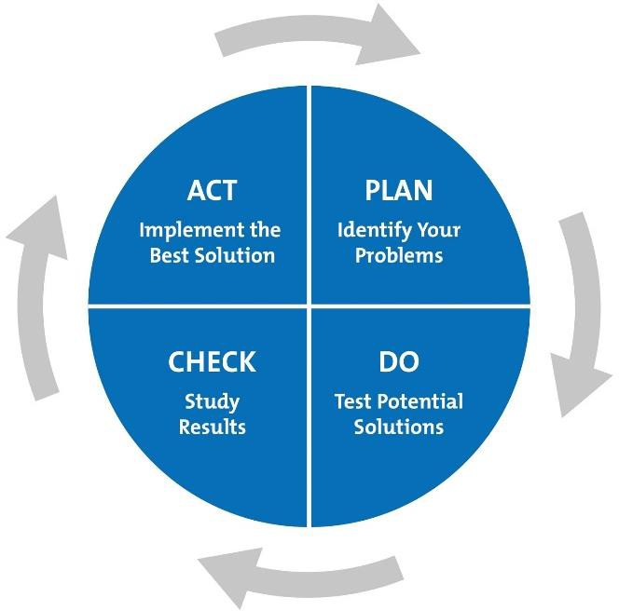
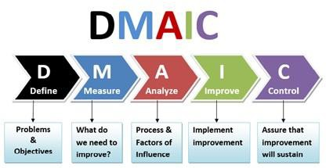
Quality and Service Improvement Methods
Process Mapping

Slide 16
‘Research is a high-hat word that scares a lot of people. It needn’t... it is nothing but a state of mind, a friendly welcoming attitude to change… going out to look for change instead of waiting for it to come. Research is an effort to do things better. It is the tomorrow mind instead of the yesterday mind.’
(Charles F Kettering)

Slide 17
Getting Involved in Research

Slide 18
Mentimeter
What specific area of practice or research aligns with your interests and career goals?

Slide 19

Getting started in research
Undertake a piece of work in practice eg. review
Joining a research team
Undertaking a higher degree
Seek funding (NIHR)
Pursuing a clinical academic career

Slide 20

Accessing library sources
Academic librarians
Searching electronic databases AND grey literature
Internet searching is a poor substitute for bibliographic databases & should not be the sole search strategy!
Register for a module in research methods? (Example: Literature searching & Information retrieval)

Slide 21
Mentimeter
What are the advantages of searching both electronic databases and grey literature in research?

Slide 22


I want to do a higher degree. Should I do an MSc, MRes, MPhil, DClin P or PhD?

Slide 23
Higher Degrees
MSc – Masters of Science, taught programme
MREs – Masters of Research, independent research project, independent learning through mini courses/seminars
MPhil – Master of Philosophy, independent research project, independent learning, preparation for a PhD
PhD – Doctor of Philosophy, highest degree, independent research, independent learning novel contribution to knowledge

Slide 24
How do I take my first steps?
Clinical staff
Find out who your R&D Divisional Lead is
Work out who is doing research in your specialist area
Opportunities for AHPs
CRF Fellowships
BRC fellowships
NIHR Integrated Academic Training Schemes

Slide 25


Routes to becoming a clinical academic
National Institute for Health Research pathway
https://www.nihr.ac.uk/explore-nihr/academy-programmes/hee-nihr-integrated-clinical-academic-programme.htm
Fellowships developed with NHS Trusts
Awards from charities eg. Arthritis Research UK

Slide 26
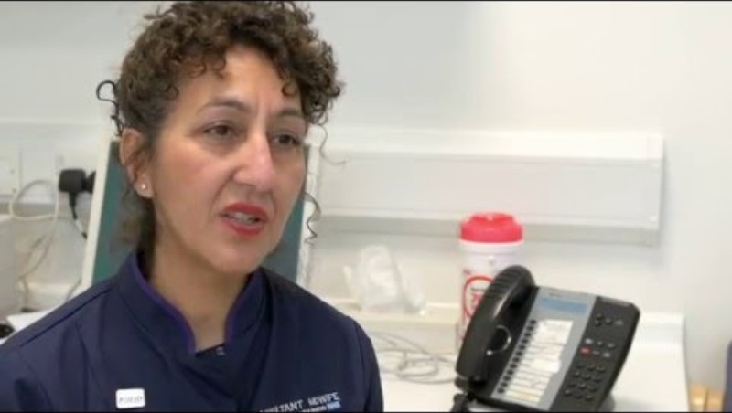
NIHR Internship Becoming a Midwife Researcher

Slide 27
How do I take my first steps – Health Professions
Clinical Academic
The Integrated Clinical Academic (ICA) Programme comprises 4 schemes -different stages of research career:
Internship Scheme
Pre-doctoral Clinical and Practitioner Academic Fellowship (PCAF) Scheme
Doctoral Clinical and Practitioner Academic Fellowship (DCAF) Scheme
Advanced Clinical and Practitioner Academic Fellowship (ACAF) Scheme
HEE-NIHR Integrated Clinical and Practitioner Academic Programme | NIHR
Research delivery
Look for health profession research delivery opportunities eg roles at the CRF
Notes:
Clinical research facility

Slide 28
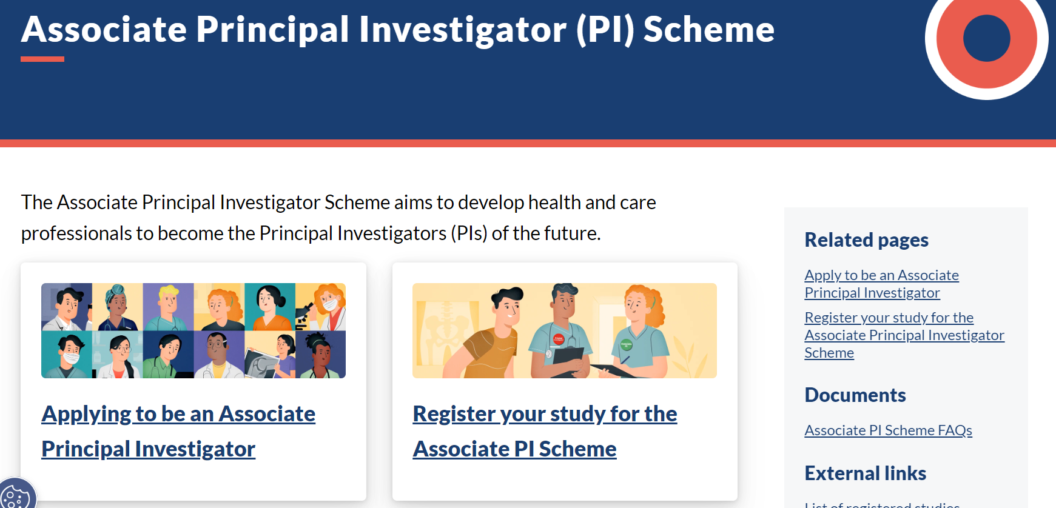
https://www.nihr.ac.uk/health-and-care-professionals/training/associate-principal-investigator-scheme.htm

Slide 29

Writing for publication
Decide on your audience
Choose a journal
Discuss with editor?
Plan your paper – how many sections / paragraphs etc
Check if there are relevant guidelines for reporting your methods
Write it
Get feedback from peers
www.caricatures-ireland.com/blog

Slide 30

Dissemination

Slide 31
Guidelines for reporting different types of studies (See www.equator-network.org/)
Type of study | Reporting guideline | Acronym
Systematic reviews | Preferred Reporting Items for Systematic Reviews & Meta-Analyses | PRISMA
Randomised trials | Consolidated Standards of Reporting Trials | CONSORT
Observational studies | Strengthening the Reporting of Observational Studies in Epidemiology | STROBE
Diagnostic / prognostic studies | Standards for Reporting of Diagnostic Accuracy Transparent reporting of a multivariable prediction model for individual prognosis or diagnosis | STARD TRIPOD
Qualitative research | Standards for Reporting Qualitative Research Consolidated criteria for reporting qualitative research | SRQR COREQ
Case reports | Case report guidelines | CARE
QI studies | Standards for Quality Improvement Reporting Excellence | SQUIRE
Economic evaluations | Consolidated Health Economic Evaluation Reporting standards | CHEERS
Study protocols | Standard Protocol Items: Recommendations for Interventional Trials Preferred Reporting Items for Systematic Reviews & Meta-Analyses - Protocols | SPIRIT PRISMA-P
Clinical practice guidelines | Appraisal of Guidelines, Research and Evaluation Reporting Items for practice Guidelines in HealThcare | AGREE RIGHT

Slide 32

Dispelling myths
Research is not only for those who aspire to be consultants or educators
Research is not superior to audit, service evaluation or quality improvement
Audit, service evaluation and quality improvement projects can be published
Quantitative research is not superior to qualitative
Patient and public involvement can be published

Slide 33
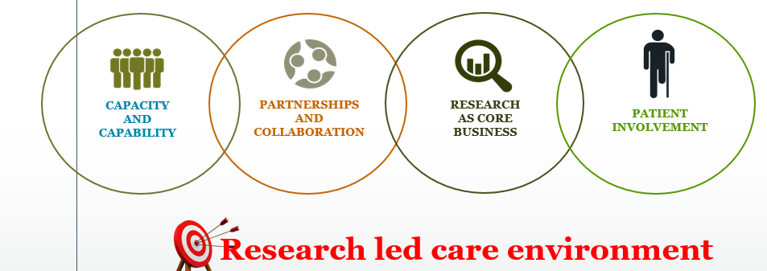
Aiming for IMPACT

Slide 34

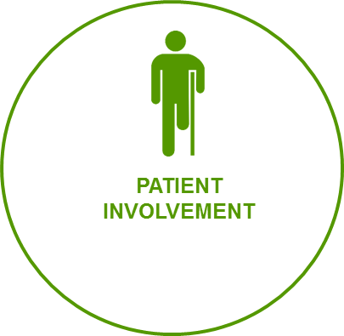
Patient and Public Involvement and Engagement
Patient and public members as co-applicants
Patients and public members to co-design research
Patients and public members co-create and support dissemination
Patient and public members to underpin our research agenda

Slide 35
Funding for the next steps in research

Slide 36
Funding Opportunities
Q Health – focuses on quality improvement projects and has funding opportunities
  Q Health
NIHR Awards
  Researcher Initiation Awards – Applied Research Collaboration Wessex
  NIHR Internship Awards
  Pre-PhD Awards, PhD, and Clinical Academic Awards

Slide 37
What next? Do some thinking and make connections
Meet people who are doing the job you aspire to – people are usually very happy to help
Find a mentor
For those aspiring to clinical academic roles
What questions do you have from practice – these are the best research questions!
Do some reading - is there a gap
Who is doing the innovative trials and studies
Work on a short proposal or pitch
Who might fund fellowship or grant?
Talk to people!

Slide 38
Resources to get you going!

Slide 39
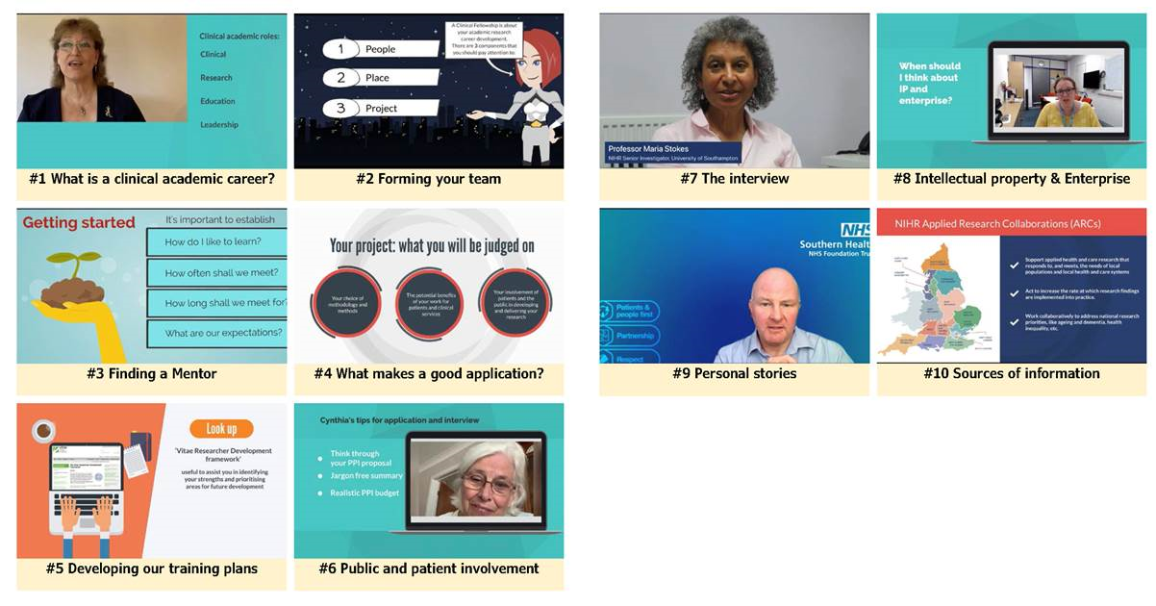
A guide to starting out in clinical academic research
https://vimeo.com/showcase/9710034

Slide 40
Regional opportunities
Southampton Academy of Research (SOAR) ‘nurture the potential of our research workforce’ https://www.soar-southampton.org/
The Academy of Research and Improvement (Solent NHS trust) ‘Growing a culture of improvement and learning’ https://www.academy.solent.nhs.uk/improvement
Southern Health https://www.southernhealth.nhs.uk/about-us/trust/quality-improvement
Hampshire hospitals https://www.hampshirehospitals.nhs.uk/our-services/az-departments-and-specialties/research-department

Slide 41
Local Opportunities
Dorset Innovation Hub - Our Dorset
Weymouth Research Hub
Dorset Opportunities in Research Network
Notes:
Our Dorset The hub is one of 4 designated Health Foundation Innovation Hubs in the United Kingdom. The innovation hub is hosted by NHS Dorset ICB as a centralised service, and is overseen by a programme group of 13 partners: primary, community secondary and social care, academia, innovation, research, economy, industry and with patient and public involvement and engagement.
Weymouth - Set up in the renovated Linden Unit at Westhaven Community Hospital in Radipole Lane, Weymouth, the hub is a joint venture between two NHS Trusts, Dorset HealthCare and Dorset County Hospital. The team will receive ongoing support from the National Institute for Health and Care Research (NIHR) Wessex, the research arm of the NHS

Slide 42
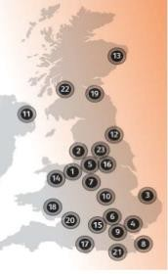
Local resources
Council for AHP Research (CAHPR)
Cheshire & Merseyside Cumbria & Lancashire East Anglia Essex Greater Manchester Hertfordshire Keele Kent & Medway London Midlands Northern Ireland North East England |  | North of Scotland North Wales Oxfordshire South Yorkshire Southern Central South, Mid & West Wales South East Scotland South West England Surry & Sussex West of Scotland Yorkshire
http://cahpr.csp.org.uk/regional-hubs-contacts

Slide 43
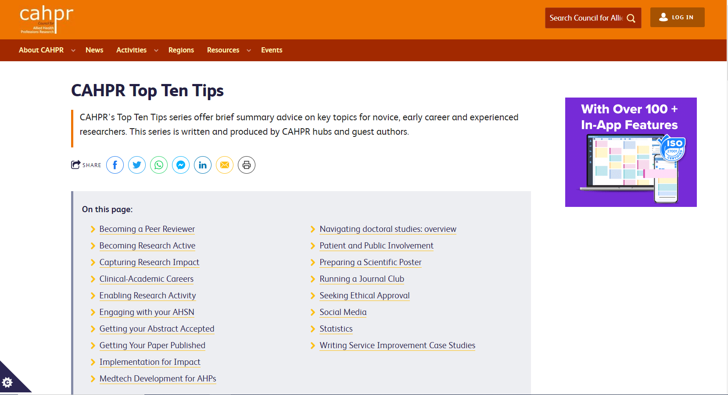
CAHPR resources
https://cahpr.csp.org.uk/content/cahpr-top-ten-tips

Slide 44
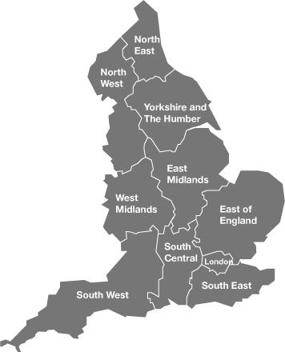
Local resources
NIHR Research Design Service (RDS)
http://www.nihr.ac.uk/about-us/how-we-are-managed/our-structure/research/

Slide 45

https://www.nihr.ac.uk/explore-nihr/support/research-support-service/

Slide 46

NIHR Research Support Service (RSS).
Provide free design and methodological support to health and social care researchers who are developing applications to NIHR and other national, peer-reviewed funding programmes
Access to RDS you can:
  Complete an online request form for individual advice or consultation https://www.rds-sc.nihr.ac.uk/request-support/
  Visit during drop-in sessions to discuss emerging ideas for research
  Guidance and resources on the website https://nihr-rss-public-health-soton.org/
  Essential Guide to Grant Applications

Slide 47
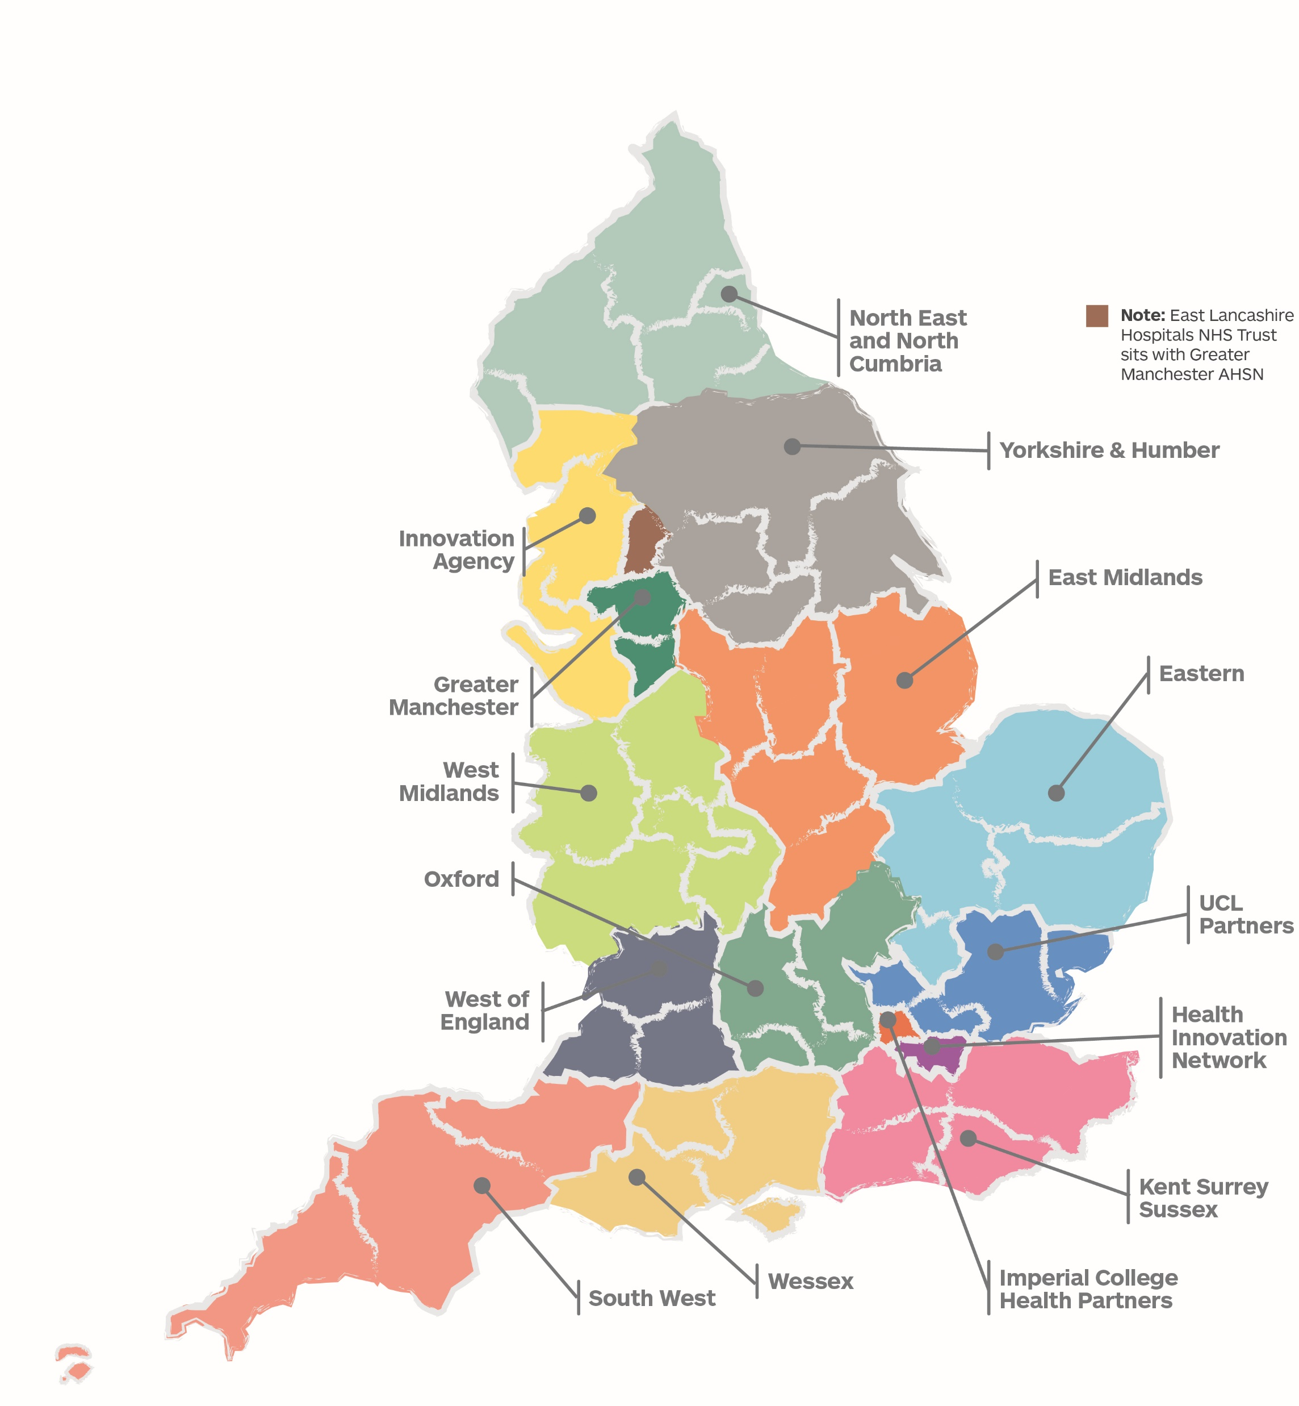
What is the AHSN Network?
Nutrition in Older People programme
Funded by NHS England and the Office for Life Sciences, AHSNs bring together the NHS, industry, academic, third sector and local organisations. Our collaboration ensures innovations, improvements and best practice benefit more patients faster.
There are 15 AHSNs across the county, improving health and generating economic growth. Each AHSN is agile and responsive, whilst staying highly connected to spread innovation at pace and scale. For further information on Wessex AHSN please visit: https://wessexahsn.org.uk/about-us or email enquiriesahsn@wessexahsn.net to connect with the team.
Launch of Healthy Ageing Programme: Scoping, review of potential innovations and request to address more basic issues, first Wessex Acute Frailty Audit
Build local networks and pan-Wessex projects to address local need. Launch hydration e-learning nationally and Nutrition Wheel. Co-leading National AHSN Healthy Ageing Network meeting
Supporting the Covid-19 response
Ongoing building of system relationships, and increased work with regional and national networks
Build national, regional NHS and care recognition. National launch of frailty e-learning. Growth across voluntary sector
Further growth of networks and national alignment. Foundation work now leading to embedding digital innovation approaches

Slide 48






6
The AHSN Network Impact Report 2021-22
National impacts 2021-22
More than 480,000 patients benefited from our national programmes and initiatives
Almost 40,000 hours
of health and care staff capacity
released through our national workforce programme
4,159
interactions
with companies
2,438
companies
supported
1,273
innovations in
our national pipeline of innovation
More than 286,000
people supported at home with
technology-enabled remote monitoring through the National Innovation Collaborative
£455m
investment leveraged
by companies supported by AHSNs
565
jobs created and
1,296
jobs safeguarded

Slide 49

The AHSN Network Impact Report 2021-22
Accelerating patient access to NICE-approved technologies and treatments
The AHSN Network work in partnership with NHS England and NHS Improvement’s Accelerated Access Collaborative (AAC), to bring together industry, Government, regulators, patients and the NHS to remove barriers and accelerate the adoption and spread of new treatments and diagnostics which can transform care.
In 21-22, we supported multiple technologies and treatments as part of the AAC’s Rapid Uptake Products (RUPs) programme and NHS England and NHS Improvement’s MedTech Funding Mandate policy.

Slide 50
Applied Research Collaborations (ARCs)
Scope
5 year (initial) award of £9M. Recently
extended to 31st March 2026.
Links universities with wider health and care system
Range goes well beyond NHS to local
authorities, other social care providers including voluntary and community sector [Integrated Care Systems]
Remit
Generate research evidence – regional priorities
Increase research capacity & capability
Mobilise knowledge – support translation
Engage and involve public members
Work with other infrastructures & networks

Slide 51


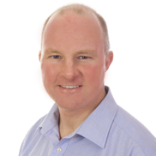

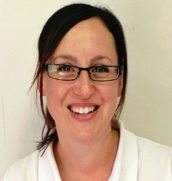
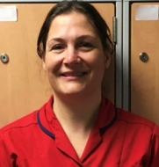
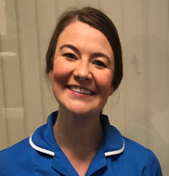


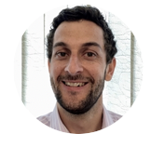
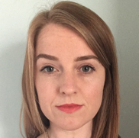
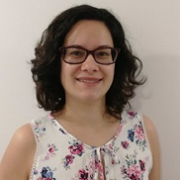


NIHR ARC Wessex
Wessex
Universities
NHS Trusts
in Wessex
Partnering with NIHR infrastructure
Voluntary
organisations
Industry partner
4
10
1
All
Mental Health Research Hub
Collaborations
South East RDS
Wessex AHSN
CRN Wessex
NHSEI
Southampton BRC
Health Education England
Southampton Academy of Research
ARCs
Wessex Patient & Public Involvement Network
ARC Wessex
Research programme
Ageing & Dementia
Long-term Conditions
Workforce & Health Systems
Healthy Communities
Academic Career Development
growing research capacity
NIHR Academy nursing & midwifery incubator support office
Social Care
50
Internships
Round 7 of
Internships
with HEE
7
PhD Awards
8
Ageing, Dementia & Frailty National Priority Research Programme Consortium
Post doctoral awards
8
Cross-ARC Dementia Programme

Slide 52
The research pipeline for the Wessex region
Each part of the local research pipeline, from discovery and invention, to diffusion and widespread implementation.
FUNDED BY | DISCOVERY | EVALUATION | ADOPTION | DIFFUSION
National Institute for Health and Care Research (NIHR)
National Institute for Health and Care Research (NIHR) & Cancer Research UK
NHS England & Office for Life Sciences
UK Research and Innovation (UKRI)
Clinical Research Network Wessex
Research Design Service South Central/South West
Applied Research Collaboration Wessex
Southampton Biomedical Research Centre
Southampton Clinical Research Facility
BioResource Centre
School for Primary Care Research
Southampton Experimental Cancer Medicine Centre & Clinical Trials Unit
Wessex Academic Health Sciences Network
Medical Research Council Lifecourse Epidemiology Centre

Slide 53
The NIHR research ecosystem mapped onto Wessex AHSN Innovation pathway
Invention
Evaluation
Adoption & spread
Early-Phase Clinical Research
Late-Phase Clinical Research
Applied Research & Evaluation
Southampton Biomedical Research Centre, Clinical Research Facility, BioResource Centre & Experimental Cancer Medicine Centre
Applied Research Collaboration Wessex & School for Primary Care Research
Wessex Clinical Research Network (renamed Research Delivery Networks (RDN) from 4/24) & Research Design Service South Central/South West (Renamed Research Support Service (RSS) incorporating CTU support from10/23)
Validation generation
Commer-cialisation
Procure-ment
Brokering
Adoption
Markets
Ideas & IP
Clinical expertise
Value proposition
Real world evidence
Trials & evidence
Health economics
Business care
Scale-up
Success
Culture
Unmet needs
PPIE
Regulatory approval
Finance
Discover
Develop
Deploy

Slide 54
Contact Us
Dr Katey Collins: kcollins@bournemouth.ac.uk
Dr Vikram Mohan: vmohan@bournemouth.ac.uk
Dr Caroline Belchamber: CBelchamber@aecc.ac.uk
Luisa Holt: L.C.Holt@soton.ac.uk

Slide 55
Additional Event
Are you a healthcare professional with a passion for improving patient care? Do you want to improve patient outcomes by leading groundbreaking research studies?
Virtual event ‘Could you be a research delivery leader?’
Wednesday 12 March 2025 from 12.30pm to 2.00pm
Full details of the event can be seen here: https://eur.cvent.me/KbkGnB

Slide 56
Questions?

