Slide 1
Scoping reviews
Dr Lyndsay Alexander

Slide 2
JBI Scoping Review Methodology group

Slide 3
Objectives:
What is a scoping review?
When to conduct a scoping review
Things to consider (before & during)

Slide 4
What is a scoping review?
A type of evidence synthesis that aims to systematically identify and map the breadth of evidence available on a particular topic, field, concept, or issue, often irrespective of source (i.e. primary research, reviews, non-empirical evidence) within or across particular contexts.
Scoping reviews can clarify key concepts/definitions in the literature and identify key characteristics or factors related to a concept, including those related to methodological research.
Munn et al 2022

Slide 5
Where do scoping reviews fit within evidence synthesis?
Quantitative systematic review
Qualitative evidence synthesis
Mixed method review
Realist synthesis
Umbrella review
Big picture reviews (Scoping reviews, EGM, Mapping reviews)

Slide 6
Campbell et al 2023

Slide 7
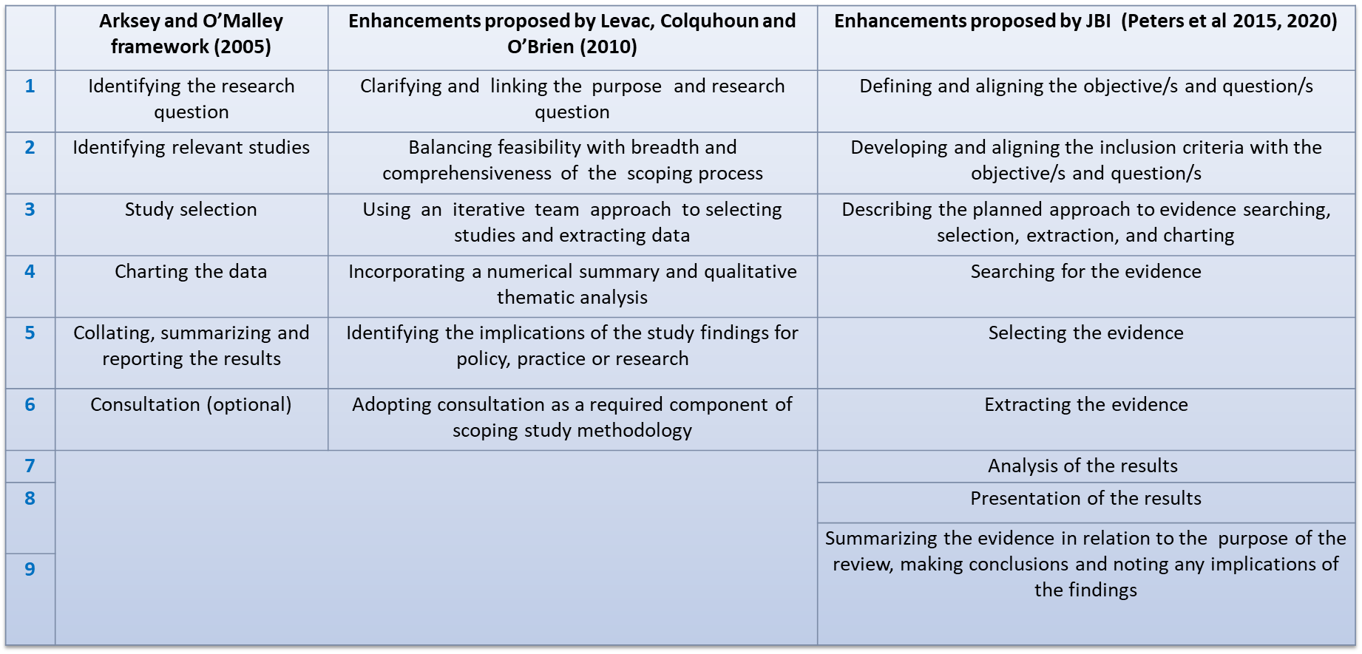
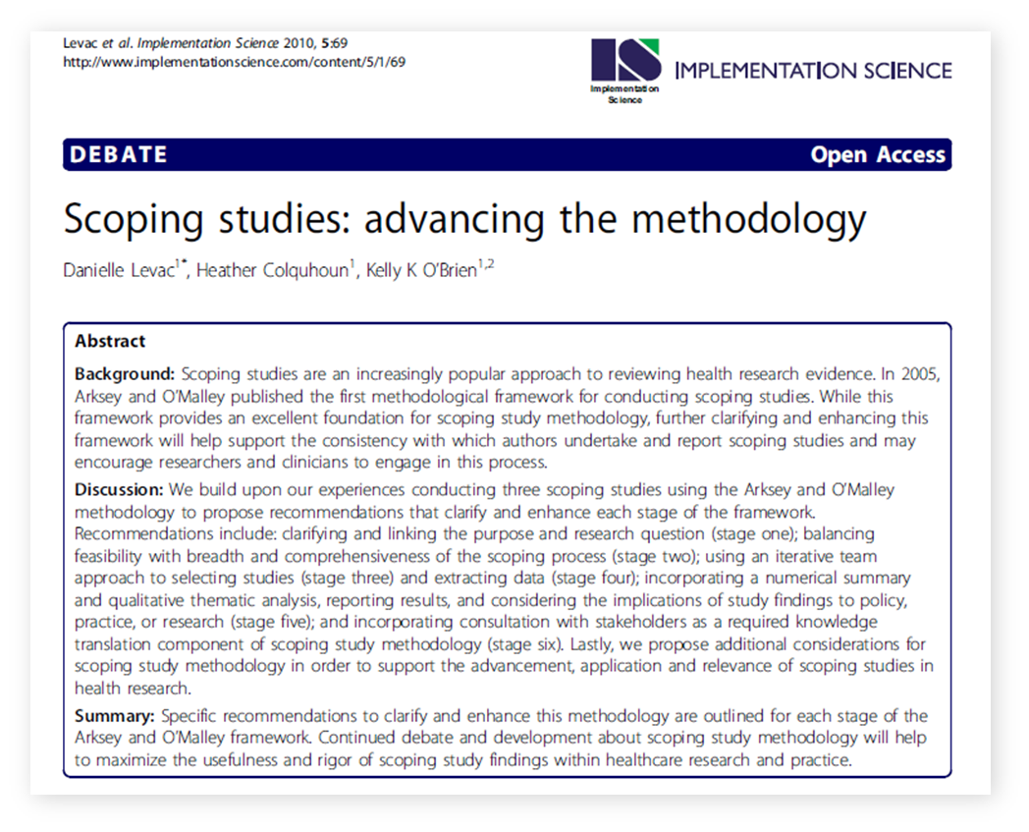
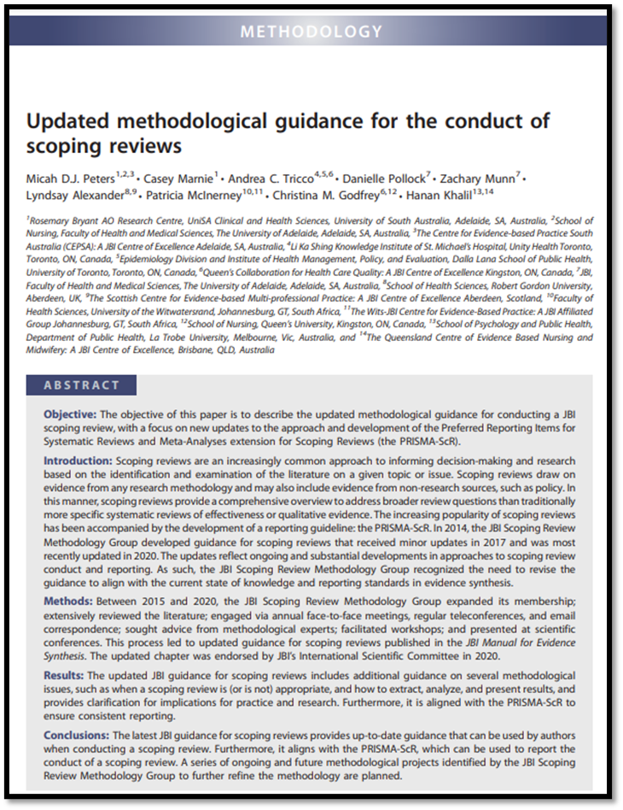
Scoping review methodology

Slide 8
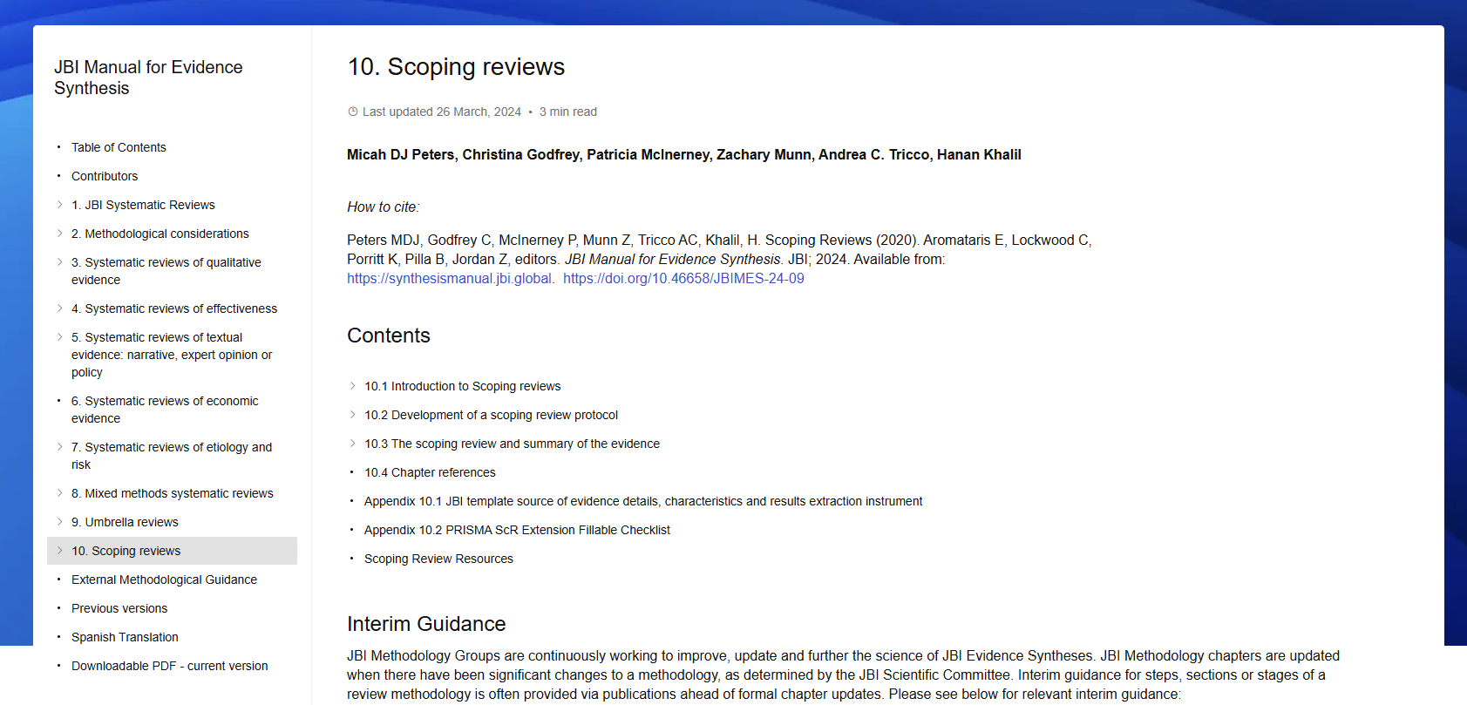
JBI Scoping Review Chapter 10

Slide 9
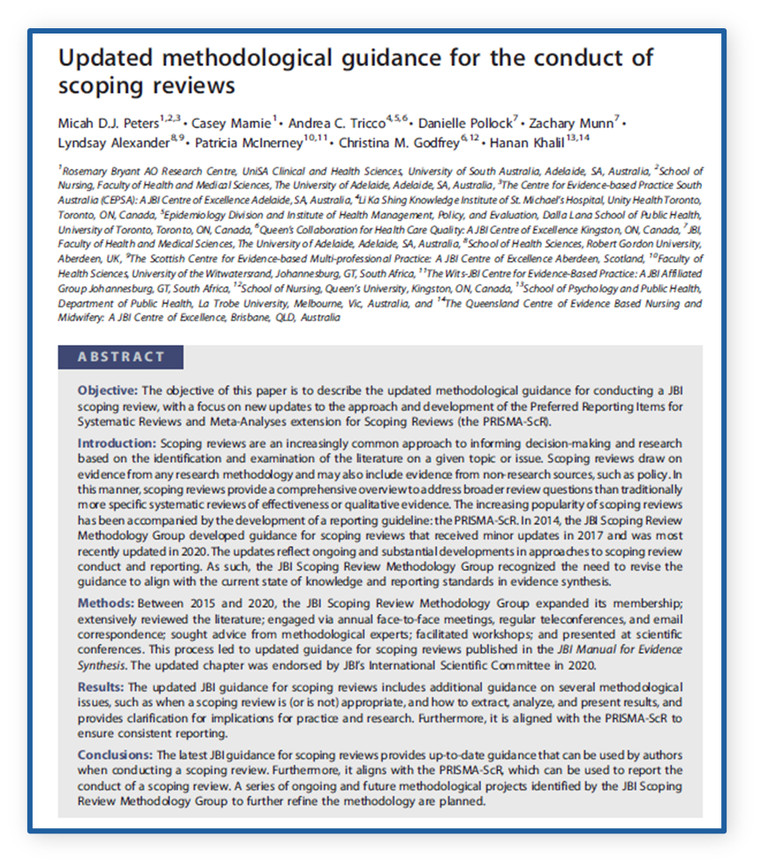
When should I conduct a scoping review?
To identify the types of available evidence in a given field
To clarify key concepts/definitions in the literature
To examine how research is conducted
To identify key characteristics or factors related to a concept
As a precursor to a systematic review
To identify and analyse knowledge gaps

Slide 10
Scoping review or Systematic review?
What question are you asking?
What are you trying to achieve with your review?
If you are interested in the identification of certain characteristics/ concepts in papers or studies, and in the mapping, reporting, or discussion of these characteristics/concepts and do not intend to make policy or practice recommendations:
A scoping review is appropriate
If you wish to answer a clinically meaningful question i.e. addressing the feasibility, appropriateness, meaningfulness, or effectiveness of a certain treatment or practice and you want your review to inform practice, policy, or procedure:
A systematic review is appropriate
Munn et al 2018

Slide 12
Misuse in scoping reviews
Avoiding critical appraisal
To “map” the literature when there is no obvious need for “mapping” in this particular subject area
Very broad questions as an alternative to investing the time and effort to refine a question for a SR
Used to change/inform practice
Easier than a SR
No or not a lot of studies (or lots of studies)

Slide 13
Things to consider - before
Protocol
Review question
PCC (Population, Concept, Context)
Resources to support
Knowledge user involvement
Peters et al 2022; Pollock et al 2022

Slide 14
Question development
Concept
Context

Slide 15
Teixeira-Santos 2022
Review question | Sub-questions
What are the multicultural competency programs that have been used in the training of health care staff and health students in academic and professional settings? | Who are the health care staff and health students attending the training programs in multicultural competencies?
 | Who are the agents conducting the training programs in multicultural competencies for health care staff and students?
 | In what specific settings are the training programs in multicultural competencies for health care staff and students implemented?
 | What are the multicultural competency domains in the multicultural care competencies training programs available for health care staff and health students?
 | What training strategies are being used for the training of health care staff and health students in multicultural competencies (eg, length, frequency, content, delivery methods)?
 | What models, theories, or principles have been used to conceptualise the training programs in multicultural care competencies available for the training of health care staff and health students?
 | What facilitators and/or barriers have been reported relating to the success and/or failure of the programs?

Slide 16
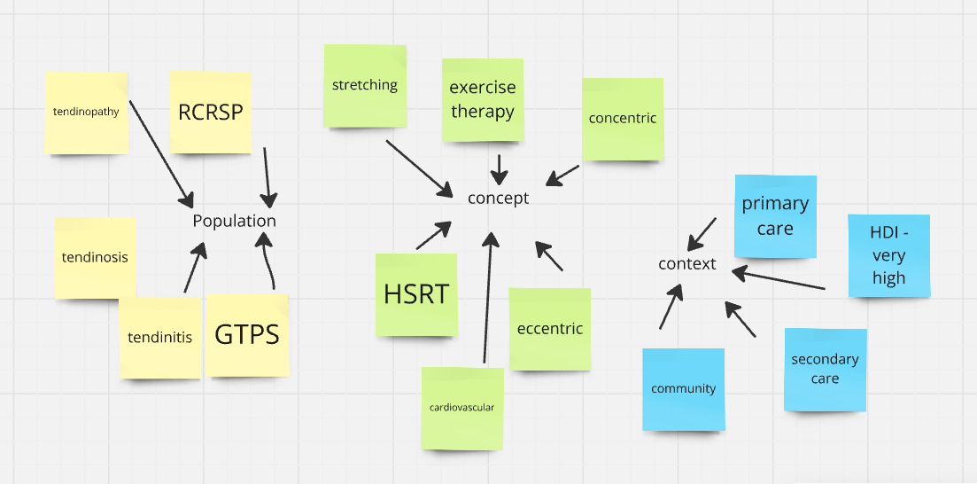
Logic grid v mind map
Population | Concept | Context
Tendinopathy Tendinitis, tendinosis, rotator cuff related shoulder pain, greater trochanteric pain syndrome | Exercise therapy Concentric, eccentric, heavy slow resistance, stretching, cardiovascular | Primary care, secondary care, community, Very high development

Slide 17
Resources
Librarian/information specialists
Number of reviewers (JBI – min 2)
Software
Searching, screening, extraction, analysis, presentation
Methodologist
Topic experts

Slide 18
Knowledge users
Clinicians/topic experts
Patients and public
Care givers
Managers
Policy makers
Leading
Controlling
Influencing
Contributing
Receiving
Pollock 2019; Pollock 2022

Slide 19
Process
Protocol
Registration
3 step search strategy
Searching, screening T&A +FT, screening included studies refs
Data extraction
Analysis
inductive, deductive; descriptive, qualitative content analysis
Presentation/write up
visualisation

Slide 20
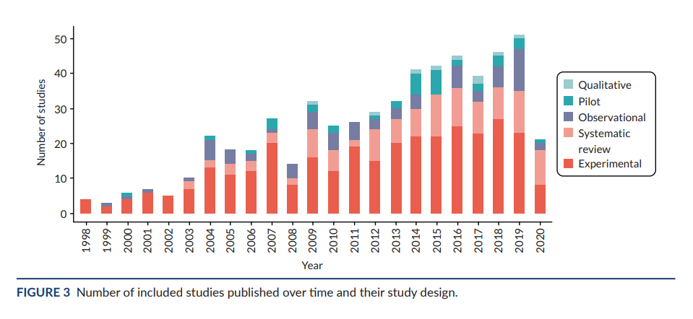
Data visualisation

Slide 21
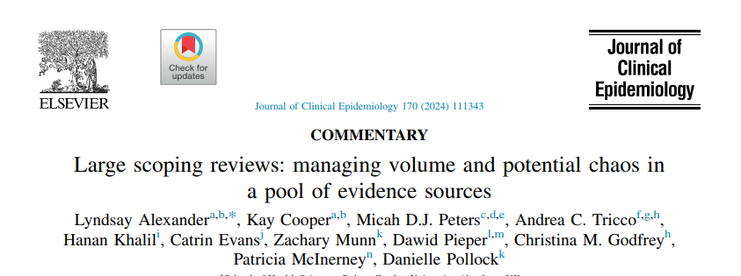
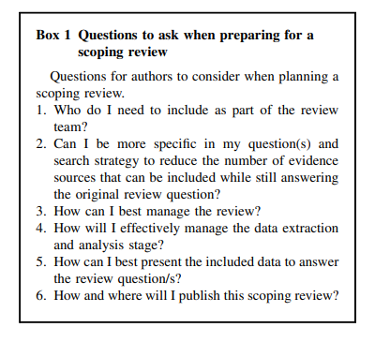
Large Scoping reviews
>100 included sources
Additional considerations

Slide 22
Top tips:
Why are you doing a scoping review?
Spend time developing your question
Engage with guidance to develop your protocol
Involve knowledge users & expertise
Librarian support
Software
Consider training in scoping review methodology

Slide 23
Thank you
@lynzalexander
l.a.alexander@rgu.ac.uk
Scottish Centre for Evidence-based, Multi-professional Practice: https://www.rgu.ac.uk/jbi-centre-of-excellence
JBI scoping review network: https://jbi.global/scoping-review-network

Slide 24
References
Munn Z, Pollock D, Khalil H, Alexander L, Mclnerney P, Godfrey CM, Peters M, Tricco AC. What are scoping reviews? Providing a formal definition of scoping reviews as a type of evidence synthesis. JBI Evid Synth. 2022 Apr 1;20(4):950-952. doi: 10.11124/JBIES-21-00483.
Campbell, F., Tricco, A.C., Munn, Z. et al. Mapping reviews, scoping reviews, and evidence and gap maps (EGMs): the same but different— the “Big Picture” review family. Syst Rev 12, 45 (2023).
Arksey H, O'Malley L. (2005) Scoping studies: towards a methodological framework. Int J Social Res Methodol. 2005;8(1):19-32.
Levac D, Colquhoun H, O’Brien KK. Scoping studies: advancing the methodology. Implement Sci. 2010;5:69.
Peters MDJ, Godfrey CM, Khalil H, McInerney P, Parker D, Soares C. Guidance for conducting systematic scoping reviews. Int J Evid Based Healthc. 2015;13(3):141-6.
Peters MDJ, Marnie C, Tricco AC, Pollock D, Munn Z, Alexander L, et al. Updated methodological guidance for the conduct of scoping reviews. JBI Evid Synth. 2020;18(10):2119-26.
Peters MDJ, Godfrey C, McInerney P, Munn Z, Tricco AC, Khalil, H. Scoping Reviews (2020). Aromataris E, Lockwood C, Porritt K, Pilla B, Jordan Z, editors. JBI Manual for Evidence Synthesis. JBI; 2024. Available from: https://synthesismanual.jbi.global. https://doi.org/10.46658/JBIMES-24-09
Munn Z, Peters MD, Stern C, Tufanaru C, McArthur A, Aromataris E. Systematic review or scoping review? Guidance for authors when choosing between a systematic or scoping review approach. BMC Med Res Methodol. 2018;18(1):143.
Pollock, D, Davies, EL, Peters, MDJ, Tricco AC, Alexander L, McInerney P, et al. Undertaking a scoping review: a practical guide for nursing and midwifery students, clinicians, researchers, and academics. J Adv Nurs. 2021;77:2102-13.
Peters, Micah D.J.1,2,3; Godfrey, Christina4; McInerney, Patricia5; Khalil, Hanan6,7; Larsen, Palle8; Marnie, Casey1; Pollock, Danielle9; Tricco, Andrea C.4,10,11; Munn, Zachary9. Best practice guidance and reporting items for the development of scoping review protocols. JBI Evidence Synthesis 20(4):p 953-968, April 2022. | DOI: 10.11124/JBIES-21-00242
Pollock, Danielle1; Alexander, Lyndsay2,3; Munn, Zachary1; Peters, Micah D.J.4,5,6; Khalil, Hanan7,8; Godfrey, Christina M.9; McInerney, Patricia10; Synnot, Anneliese11,12; Tricco, Andrea C.9,13,14. Moving from consultation to co-creation with knowledge users in scoping reviews: guidance from the JBI Scoping Review Methodology Group. JBI Evidence Synthesis 20(4):p 969-979, April 2022. | DOI: 10.11124/JBIES-21-00416
Teixeira-Santos, Luísa1; Camarneiro, Ana Paula1,2; Xavier, Beatriz1; Ventura, Filipa1; Cunha-Oliveira, Aliete1; Monteiro, Ana Paula1. Multicultural competencies training programs for health care staff and health students in academic and professional settings: a scoping review protocol. JBI Evidence Synthesis 20(2):p 613-623, February 2022. | DOI: 10.11124/JBIES-21-00102
Pollock, A. , Campbell, P. , Struthers, C. , Synnot, A. , Nunn, J. , Hill, S. , Goodare, H. , Morris, J. , Watts, C. & Morley, R. (2019). Development of the ACTIVE framework to describe stakeholder involvement in systematic reviews. Journal of Health Services Research & Policy, 24 (4), 245-255. doi: 10.1177/1355819619841647.

