Slide 1
Measuring Impact
Dr Judith Lane, Queen Margaret University, CAHPR Scotland

Slide 2
Overview
What is impact?
Why is it important to measure impact?
How does impact measurement differ from research
Steps to impact measurement
Notes:
Today we are going to cover these four key areas. The overall aim of the session is to increase your awareness of impact measurement methodology and give you some ideas of where to start in your own practice

Slide 3
What is impact?
To have a significant effect on something
Can be POSITIVE / NEGATIVE
Can be INTENDED / UNINTENDED
Notes:
Simply put impact is when our actions have a significant effect on a particular characteristic of people, or services. These outcome can be both positive or negative, or a combination of both. The impact may not also always be the one which is intended.

Slide 4
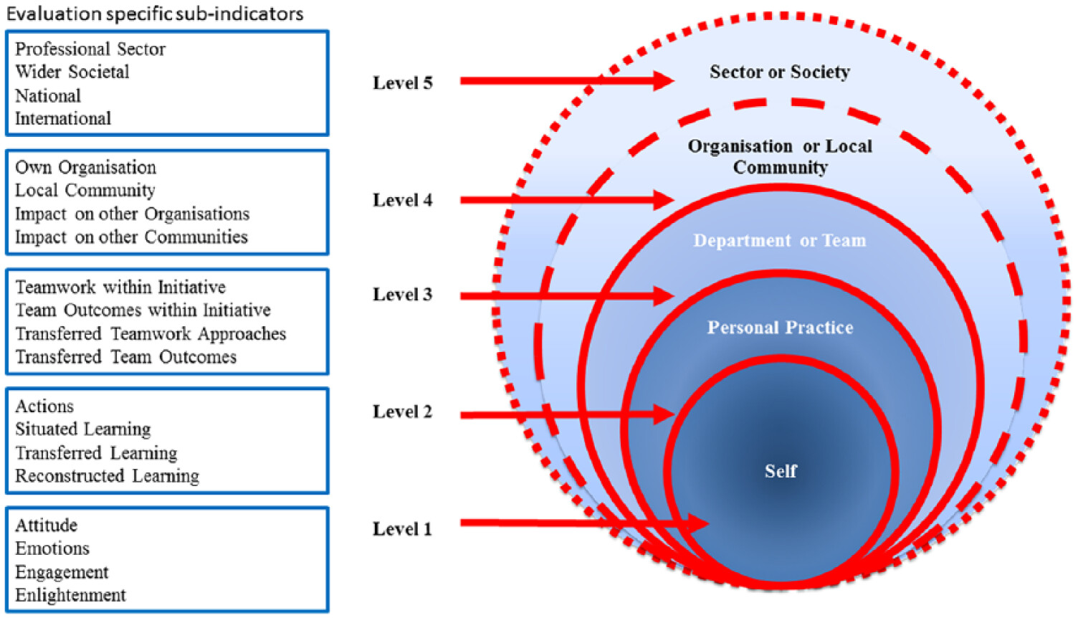
Evidence of Impact Model (Harper et al, 2020)
Notes:
Motivation and morale of an individual (Level 1) may be greatly influenced by recognising their own contribution to their team’s or community’s success (Levels 3 or 4). This newly bolstered or diminished morale for the individual (Level 1) may also impact upon the individual’s ability to act (Level 2) and their ability to influence change within their team (Level 3). Conversely, impact created by the team (Level 3) may impact simultaneously upon both the individual involved (Levels 1 and 2) and the organisation or local community (Level 4). In this example, impact is two-way or more, pushing both inwards and outwards within the model, as demonstrated in Figure 2.

Slide 5
Why measure impact? (InFocus)
Report to funders
Attract new funders
Improve your activities
Highlight your successes
To share with others
Notes:
By using an evaluation approach we can build a better understanding of the impact different projects have on different groups. This information can then be used to inform the design of future projects and hopefully improve their success

Slide 6
Your ideas
Have you got an idea about a service, project or initiative that could benefit from a structured impact measurement?

Slide 7
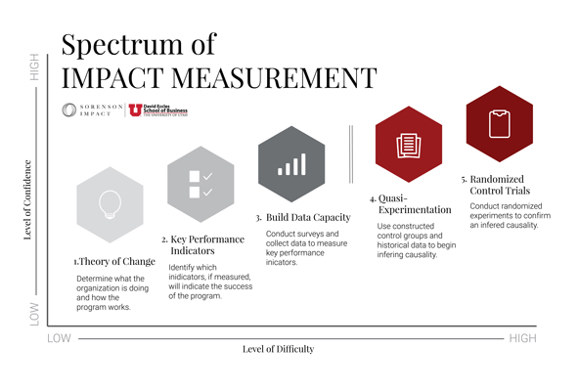
Options for measuring impact (Hadley et al 2018)
Notes:
Impact measurement can be considered as on a spectrum of research. Whilst randomised controlled trials might be the gold standard for establishing cause and impact, they are expective, difficult and may not always be ethically feasible to conduct.
Impact measurement however is generally easier to conduct, does not aim to generalise findings from a sample but instead aims to understand how your specific project, initiative or service makes a difference to the people and communities that access it.
Impact measurement and experimental studies do share some characteristics – there should be some logical association between the activity and outcome i.e. if we do this….then we expect the impact or outcome to be that…Both will also use data collection methods to evaluate the outcome but the requirements to infer causality are not as great in impact measurement

Slide 8
NPC Four Pillar Approach (Kazimirski & Pritchard 2014)
Notes:
New Philanthropy Capital (NPC) is social sector think tank and consultancy. They produce lots of resources on impact evaluation and have produced this four pillar approach.
Building a solid rationale for impact measurement combined with clear leadership will provide a strong foundation upon which to plan impact measurement.

Slide 9
Underpinning principles of impact measurement (NHS England, n.d.)
Be clear about what you are trying to achieve
There is no one absolute measure of value- focus on creating a good enough account of value at a point in time
Judgements of value can, and should be made by those involved in the work
Involve stakeholders at meaningful intervals
Don’t dismiss the elements of value which are harder to capture
Keep it simple and transparent
Focus on learning, not just accountability

Slide 10
Steps to Impact Measurement (Willett et al, 2021)

Slide 11
Step 1: Articulate what will change and why
Outline what you expect to change, how and why, in a single document
Identify the key issues being addressed by the programme, project or service.
Provide a narrative, using published literature or existing evidence to support the development of your rationale
Link to national and local priorities as well as identifying stakeholder priorities
Identify what you are aiming to achieve, why and how
Logic models which clearly articulate your working hypotheses
Driver of change diagrams

Slide 12
Steps to theory of change (NPC)
Situation analysis
Target groups
Impact
Outcomes
Activities
Change mechanisms
Order & sequencing
ToC diagram
Stakeholders and enablers
Assumptions

Slide 13
Logic models
Logic models provide a simple outline of your project/, service or initiative which supports your planning, communication and management of activities.
Two kinds of logic models
Weavers Triangle
The Wisconsin Model

Slide 14
Weavers Triangle

Slide 15
The Wisconsin Model
Taylor-Powell et al 2003

Slide 16
Articulate your change: Maximise health & well-being for frail elderly (logic model)
SITUATION:
Inequality in provision of care and wide variation in quality of care
Fragmented health and care system and inefficiencies
Health organisations and local Authorities are under financial pressures
Over dependence on in-patient care - high number of avoidable admissions
ACTIVITIES:
OUTCOMES:
GOAL:
Early intervention & proactive support
Person centred & planned care delivery
Coordinated care across health, social care & mental health
Joint approaches to budgets & contracts
Ready access to community-based care
Faster, more consistent care across the local system
Increased choice and control over own health & care needs
Improved collaboration & coordination of care
Improved experience of care
Reduced avoidable admissions, A&E visits etc.
Reduced overall cost of care & support
All the frail elderly living in the area receive the most appropriate care and support they need in the right place and at the right time
ASSUMPTIONS:
There will be a realignment of resources as stakeholders work together; Cultural change takes place; There are national levers to support the programme; Partners will have freedom to implement changes to work differently.

Slide 17
Articulate your change: Maximise health & well-being for frail elderly (driver diagram)
Person centred & planned care delivery
Personalised care plans available for all
Increased choice and control over own health & care needs
Coordinated care across health, social care & mental health
All the frail elderly living in the area receive the most appropriate care and support they need in the right place and at the right time
Improved experience of care
Ready access to community-based care
Faster, more consistent care across the local system
Early intervention & proactive support
Improved signposting to community-based services
Reduced overall cost of care & support
Reduced avoidable admissions, A&E
visits etc.
Joint approaches to budgets & contracts

Slide 18
Step 2: Capture output and outcome measures
Capture evidence of the activity, outcome, goals
Prioritise those aspects which are a priority for your activities
Consider any issues or limitations
Consider how Contribution Analysis can help you make evidence based causal claims
Consider the most likely and plausible explanations

Slide 19
Outcomes
The changes or benefits that are delivered as a result of the service, project or initiative
Should reflect the shared goals and collective aim of the various stakeholders
Co-production of outcomes is therefore critical and requires two steps
1. Understand your stakeholders
2. Engage your stakeholders

Slide 20
Engaging stakeholders (Inspiring Impact 2020)
 | Level of Involvement
 | Consultation | Conversation | Participation
Plan: Decide what data to collect | Ask users what they think of your evaluation priorities. | Discuss your priorities. | Involve users in deciding your priorities.
Do: Collect data | Ask users what they think of how you collect data. | Discuss how you will collect data. | Involve users in collecting the data.
Assess: Analyse data | Ask users what they think of your analysis - do they challenge or agree with your interpretation? | Discuss and refine your findings together. | Involve users in analysing and making sense of the findings.
Review: Present and use data | Ask users what they think of how you plan to respond. | Discuss recommendations and actions. | Involve users in taking action with you.
Notes:
Involving service users in your impact practice can be useful for several reasons:
● By better understanding users’ needs, while harnessing their knowledge and skills, it can help you prioritise and target your evaluation activities. ● It can strengthen staff-user relationships, helping to build user support for and engagement with data collection and evaluation. ● Showing that you listen to and involve users can have direct benefits, giving them a sense of confidence and agency. ● User involvement can give credibility to your findings about the impact your work is having, demonstrating that users’ views are valued and considered.
How can you involve service users?
You can involve people at different stages, and different levels, of your impact practice. At its most basic, this might mean asking people what they think of your priorities and overall approach. At its most involved, users might participate throughout your impact practice. They could co-design evaluation processes and tools, or sit on your board.

Slide 21
Setting outcomes (Evaluation Support Scotland 2020)
Outcomes are not the specific measures, they are statements of change/benefit which you expect to see
Outcomes should… | Example
Reflect the identified need of the population and relate to the purpose of the project/service/initiative | Participants will demonstrate increased levels of physical activity
Reflect the logic model and the expected difference eg IF we do this….THEN the result should be… | IF we provide opportunities for engaging in physical activity THEN participants will do more physical activity
Not be confused with outputs. Outputs are the activities, the outcome tells us what will change | Exercise class is the output Increased physical activity is the outcome

Slide 22
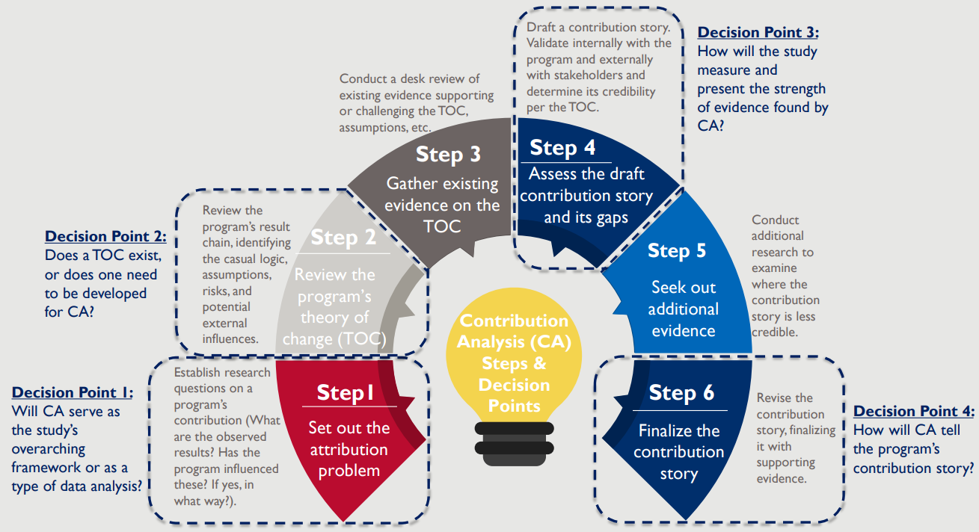
Contribution Analysis (Mayne, 2012)
Usually based on theory-of-change
Aims to make credible causal conclusions where experimental approaches are not possible
Aims to understand the contribution that an intervention is making to observed results by considering why results did or didn’t occur, taking into account other influencing factors such as assumptions or external factors.
Thompson, 2022

Slide 23
Causality from contribution analysis (Mayne, 2012)
The following steps allows causality to be inferred
The intervention is based on a reasoned ToC, informed by evidence and with input from key stakeholders.
The intervention/activity was implemented as planned
The outcomes provide evidence for the ToC
External factors which could influence the outcome are considered
Overall a contribution claim is then developed
Contribution claim = a verified theory of change + other key influencing factors accounted for
Notes:
The intervention is based on a reasoned ToC, the assumptions behind why the intervention will work are plausible, informed by evidence and with input from key stakeholders.
The intervention/activity was implemented as planned
The outcomes provide evidence for the ToC
External factors which could influence the outcome are considered and their contribution determined.
Overall a contribution claim is then developed
Contribution claim = a verified theory of change + other key influencing factors accounted for

Slide 24
Step 3: Review the evidence
Once you have collated (existing) evidence and collected new evidence, the next step is to review the evidence.
Are expected changes happening?
Are changes required?
Do we need any additional/alternative evidence?
Are there any gaps in what we know?
Tailor the presentation of the data to the audience

Slide 25
And finally….
Share your impact story – how the Pixar Pitch Framework can help you tell your story
https://www.causevox.com/blog/pixar-pitch-framework/

Slide 26
Tell your story: The Pixar Pitch Framework
Your programme
 | Your Programme
Once upon a time | There was inequality in provision of care and wide variation in quality of care. A fragmented health and care system and inefficiencies led to duplication; inadequate collaboration and coordination of care.
Every day | Health organisations and local authorities struggle with financial pressures and there is an over dependence on in-patient care with high numbers of avoidable admissions.
One day | A group decides to work together to apply the principles of large scale change to tackle the problems.
Because of that… | We achieve improved collaboration and greater coordination of care needs, which leads to faster, more consistent care across the local system. Service users experience increased choice and control over own health and care needs.
Because of that… | We see improved experience of care and support. There is a reduction in voidable admissions, A&E visits etc. This leads to a reduction in overall cost of care and support and a more productive health economy.
Until finally | People with or at risk of developing complex care needs receive the most appropriate care and support they need in the right place and at the right time.

Slide 27
Where do I go next
Resources
https://www.england.nhs.uk/nhsimpact/
https://www.thinknpc.org/starting-to-measure-your-impact/
Taught modules
QMU – Demonstrating Impact in Practice - https://www.qmu.ac.uk/study-here/postgraduate-study/2024/msc-pgdip-pgcert-advancing-practice-in-health-advancing-practice-in-health-framework/

Slide 28
References
Allen K. Storytelling Secrets from Pixar. https://www.causevox.com/blog/pixar-pitch-framework/ (31 March 2025, date last accessed]
Evaluation Support Scotland (2020). ESS Support Guide 1a: Setting Outcomes [online] [accessed 23 Sept 2020] Available from http://www.evaluationsupportscotland.org.uk/resources/427/
Hadley, D., Zadra, J. R., Reynolds, G., Cox, L. C., & Fritz, N. (2018). A Playbook for Designing Social Impact Measurement. Stanford Social Innovation Review. https://doi.org/10.48558/ET2C-KQ59​
Harper, L. M., Maden, M., & Dickson, R. (2020). Across five levels: The evidence of impact model. Evaluation, 26(3), 350- 366. https://doi.org/10.1177/1356389019850844
INFOCUS, n.d. 7 Steps to Effective Impact Measurement [online] [Accessed 20th August 2020] Available from https://www.undp.org/content/dam/ukraine/docs/DG/socinnov/7%20Steps%20to%20Effective%20Impact%20Measurement_v3_13.12.16%20(1).pdf​
Kazimirska, A., & Pritchard, D. (2014). Building your measurement framework: NPC's Four Pillar Approach. NPC New Philanthropy Capital Available from https://npproduction.wpenginepowered.com/wp-content/uploads/2018/07/NPCs-four-pillar-approach-FINAL.pdf
Mayne, J (2012) Contribution analysis: coming of age? Evaluation, 18(3), 270- 280. https://doi.org/10.1177/1356389012451663
NHS England (n.d) Impact Framework [online] [accessed 23nd March 2023] Available from https://www.england.nhs.uk/sustainableimprovement/impact-framework/
Thompson c (2022) Decision points in contribution analysis. Available from https://usaidlearninglab.org/community/blog/decision-points-contribution-analysis
Willett J, Barclay M, Mukoro F, Sweeney G (2021), Telling the story of complex change: an Impact Framework for the real world, International Journal for Quality in Health Care, V33(3), https://doi.org/10.1093/intqhc/mzab090
Wolpert, M., Rutter, H. Using flawed, uncertain, proximate and sparse (FUPS) data in the context of complexity: learning from the case of child mental health. BMC Med 16, 82 (2018). https://doi.org/10.1186/s12916-018-1079-6
Evaluation Support Scotland (2020). ESS Support Guide 1a: Setting Outcomes [online] [accessed 23 Sept 2020] Available from http://www.evaluationsupportscotland.org.uk/resources/427/

