Slide 1


Webinar: Co-production: the power of us.
6.11.2025

Slide 2




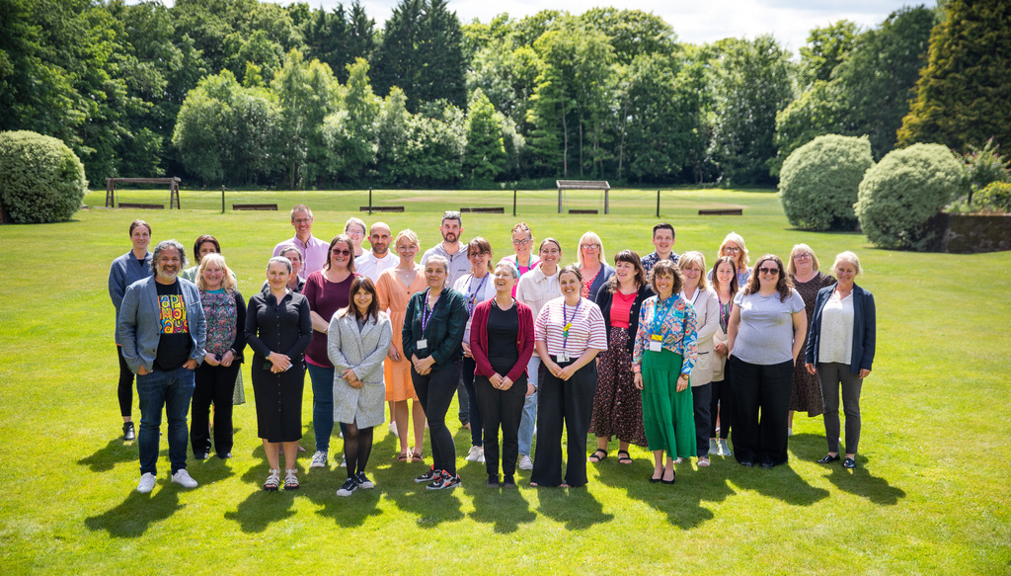
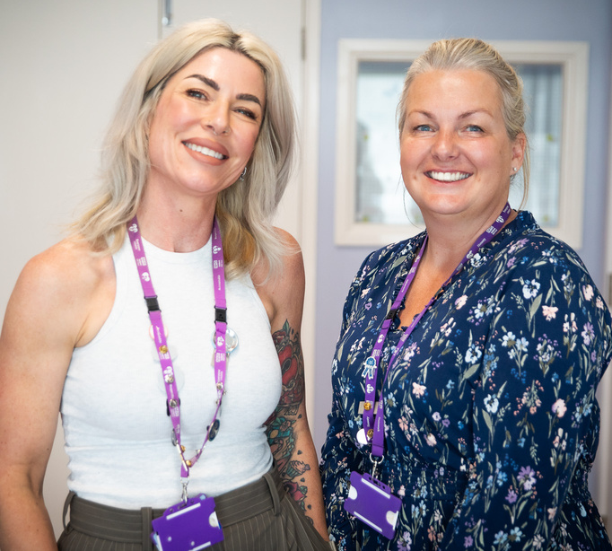
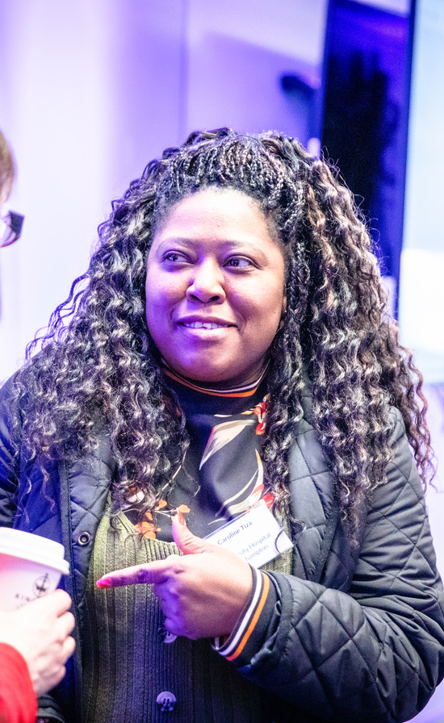
Co-production in research
Carl Adams
Head of Improvement and Participation
Physiotherapist
Nov 2025

Slide 3


The Academy
of Research and Improvement
Hampshire and Isle of Wight Healthcare NHS Foundation Trust
We empower staff and patients to drive research and improvement by building skills, confidence, and capability. From training and facilitation to events and our annual conference, we support projects in Research, Improvement, Clinical Effectiveness, Innovation, Patient Involvement, and Evidence Sharing - helping teams turn ideas into impact.
Training, workshops and drop-ins | 2025 Academy

Slide 4




The 'What' of co-production
Shaping research by what matters to people
Research is:
Carried out ‘with’ or ‘by’ people
Research Isn't:
Carried out ‘to’, ‘about’ or ‘for’ them

Slide 5
What are the benefits of involving patients in research?
Offers a different perspective and an insight into how it feels to be part of research | Highlights and addresses health inequalities | Improves the quality of the research – participation | Improves the health and wellbeing of the person involved | Requirement for grant applications
Focus of research on what matters to people -prioritise topics, generate new ideas | More sustainable, with better outcomes | Builds public confidence, understanding and support for research | Utilises or helps them develop their confidence, experience and skills | Quality of ethics
Notes:
CA slide- discuss anything not raised by patients

Slide 6
What is Patient and Public Involvement and Engagement?
PPIE means actively involving patients and the public in the activities and design of research (Involvement)
PPIE includes making people aware of research (engagement)
Involvement People are actively involved in research projects and in research organisations. | Participation People take part in a research study (they are participants in a research study) | Engagement Information and knowledge about research is provided and disseminated | Community Engagement Raising awareness of research with communities Creating the conditions for these communities to be involved in and participate in research.
Guidance for applicants on working with people and communities | NIHR

Slide 7

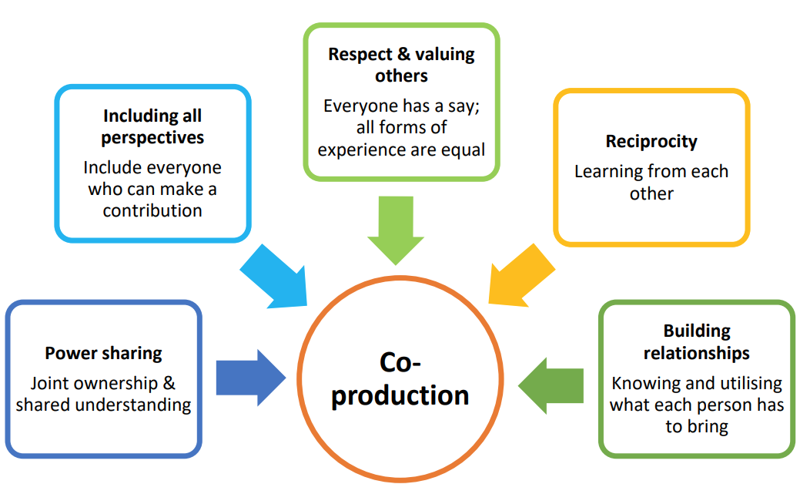
What is co-production in research?
‘Co-producing a research project is an approach in which researchers, practitioners and the public work together, sharing power and responsibility from the start to the end of the project, including the generation of knowledge.’
(NIHR, 2024).
This incorporates the principles of:
Reference

Slide 8
Identification & Prioritisation
Analysis and Interpretation
Dissemination
Implementation
Evaluation
Grant application
Recruitment and Data Collection
Design
What are opportunities to work alongside patients and people?
The Research Process

Slide 9
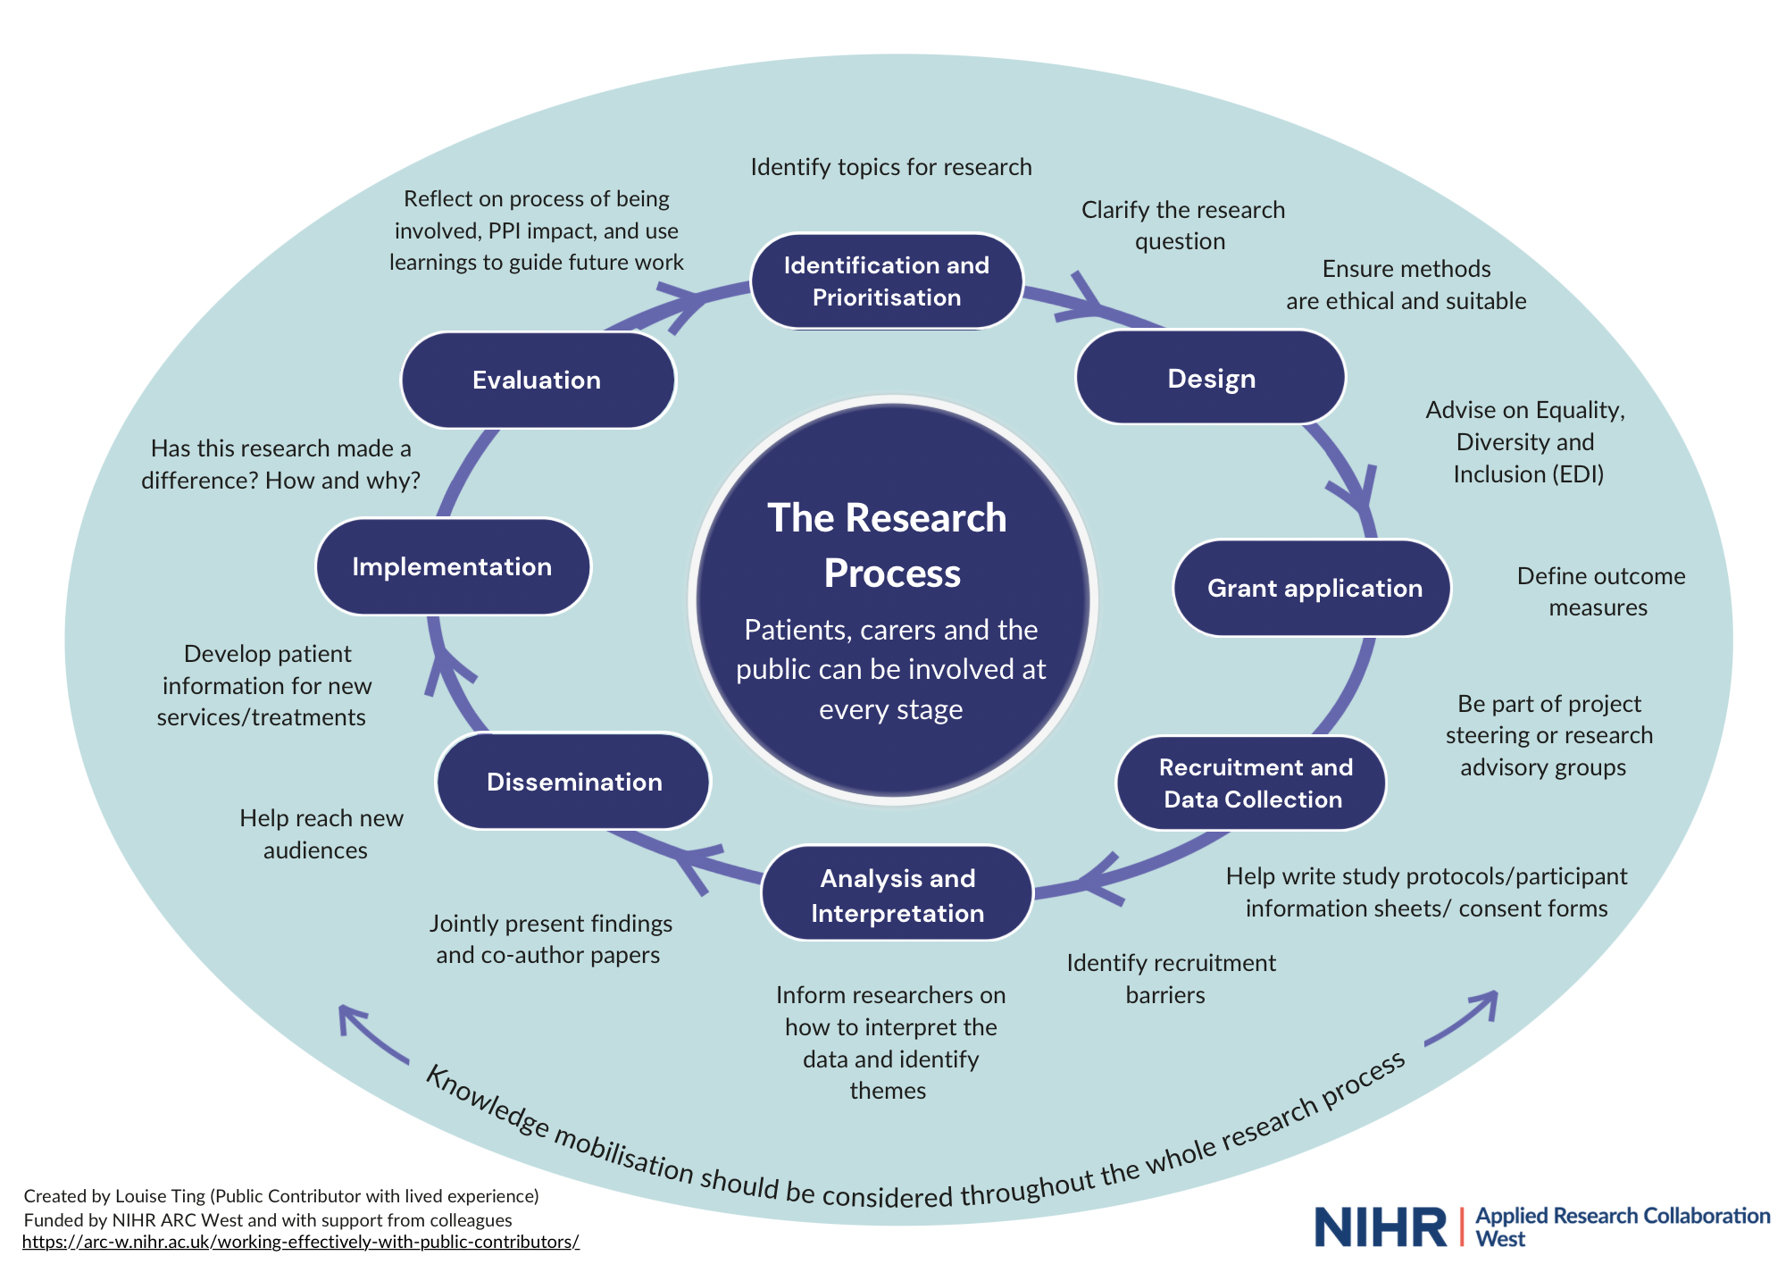
Notes:
Handout

Slide 10
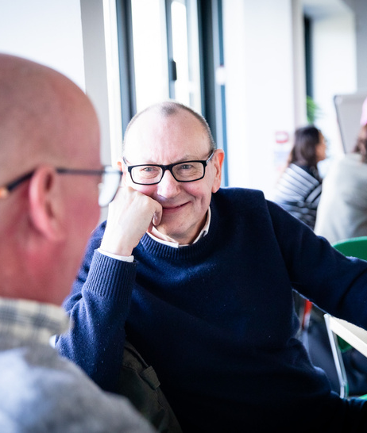
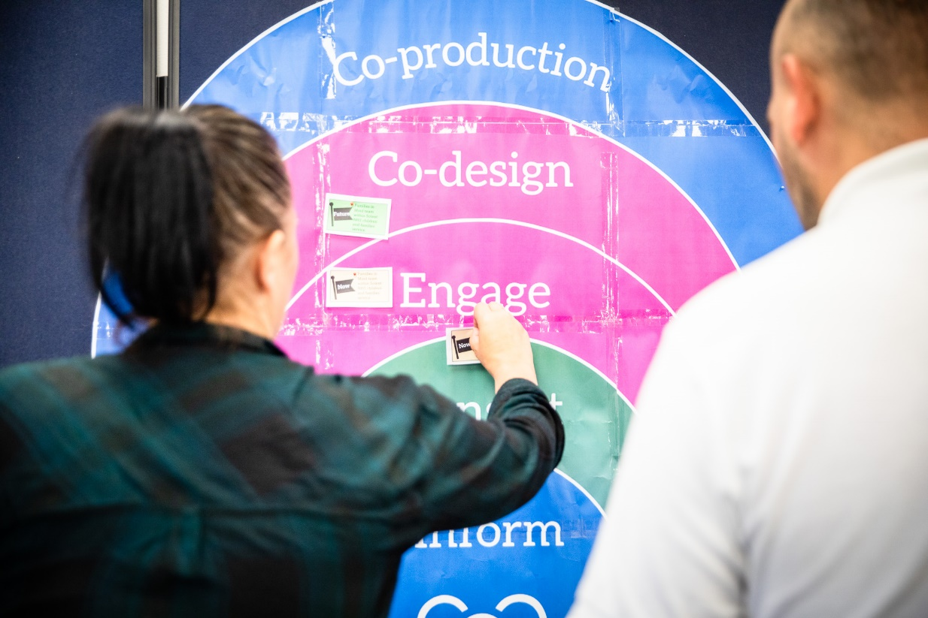
Applying these principles throughout the research process
Notes:
Questions to panel
An example of your involvement and what difference it made?
What was good about this? What do you wish happened more
Where would you like to be involved more?
examples of what PPI we have done and how that relates to the wheel on the on the previous slide
what are our opinions/experiences on the essential ingredients for involving patients and public well
What are the things to avoid

Slide 11





hiowh.takepart@nhs.net
Contact us
For more information please visit the Academy website, intranet pages and social profiles
/solentacademy
@hiowhacademy
academy.hiowhealthcare.nhs.uk
Participation Team - hiowh.takepart@nhs.net
Academy of Research & Improvement
@hiowacademy
@hiowhacademy

Slide 12



oung people as researchers
Mary Barker
School of Health Sciences, Faculty of Environmental and Life Sciences AND MRC Lifecourse Epidemiology Centre, Faculty of Medicine, University of Southampton, UK;
CAHPR webinar, 6 November 2025

Slide 13

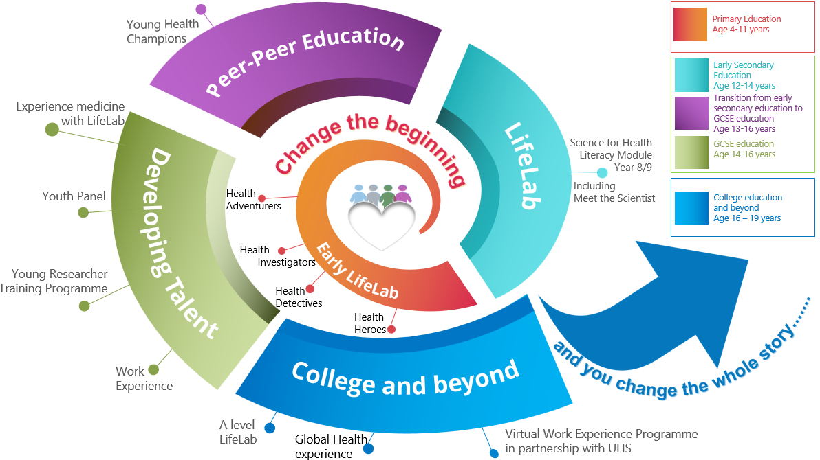
NxtGen Researcher Programme

Slide 14

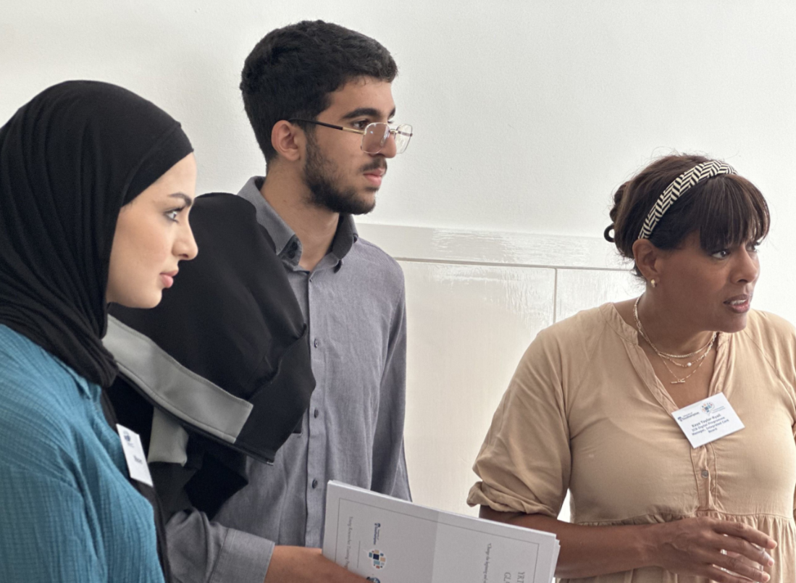
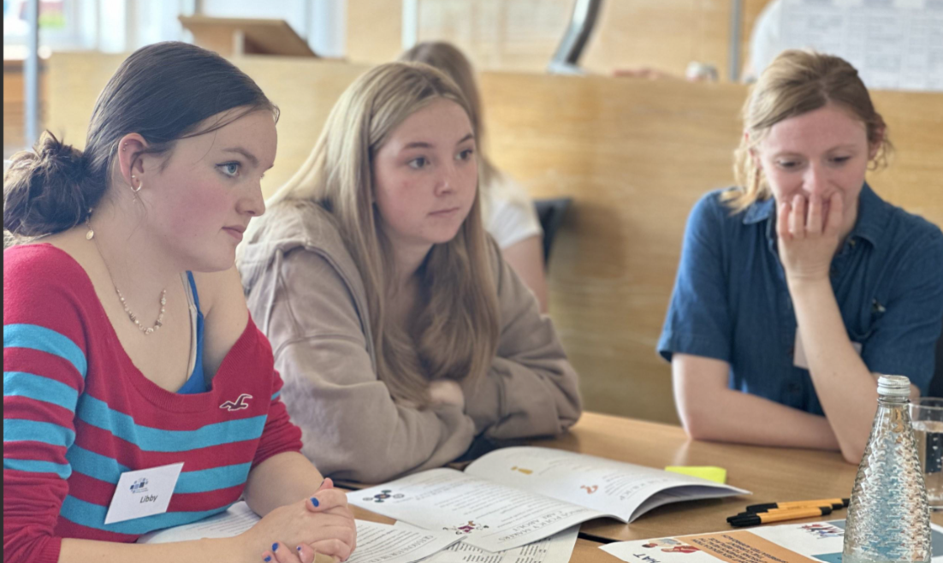

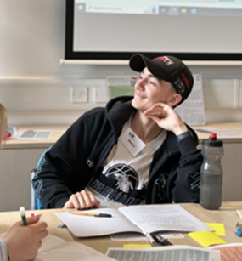
16 weeks training, by and for YP
Paid employment accessible to all young people
Developing a corps of young researchers who partner in our research and have skills to help them achieve their aspirations
Trains YP to collect meaningful data in an ethical way, and to use it to advocate for change
NIHR funded shareable training resources including session plans, videos, and worksheets hosted on a bespoke learning management system
Transformational effect on participants
Vital, honest insights, young people see the world differently.
Close working with local decision-makers where research feeds directly into policy and practice
‘Meaningful participation of young people in decision-making promotes social cohesion, creates more equal communities and helps adolescents make better informed and more empowered transitions to adulthood.’ (Patton et al. Lancet 2016)

Slide 15
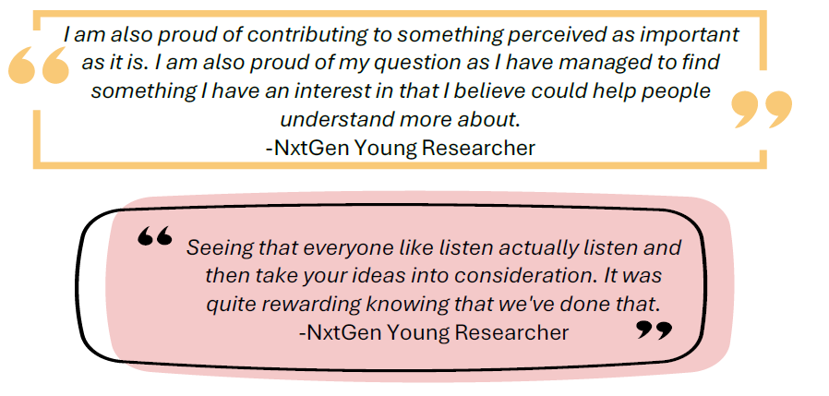


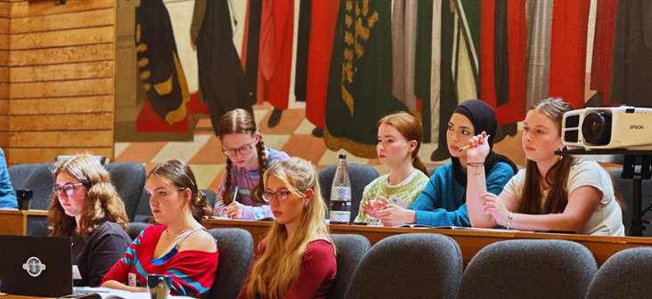

Slide 16
Power dynamics and autonomy
Fair value exchange – compensation
Giving young people control over their work & environment
Removing ‘observers’ and limiting number of adults in the room

Slide 17
Resources
NHS Sussex Chair showcases Community Research Project – Brighton & Hove LGBT Switchboard
Co-production: what it is and how to do it – SCIE
NHS England » Co-production

