Slide 1




Be Part of Research
Ashley Minchin - Stakeholder Engagement Manager NIHR Research Delivery Network Coordinating Centre ashley.minchin@nihr.ac.uk

Slide 2
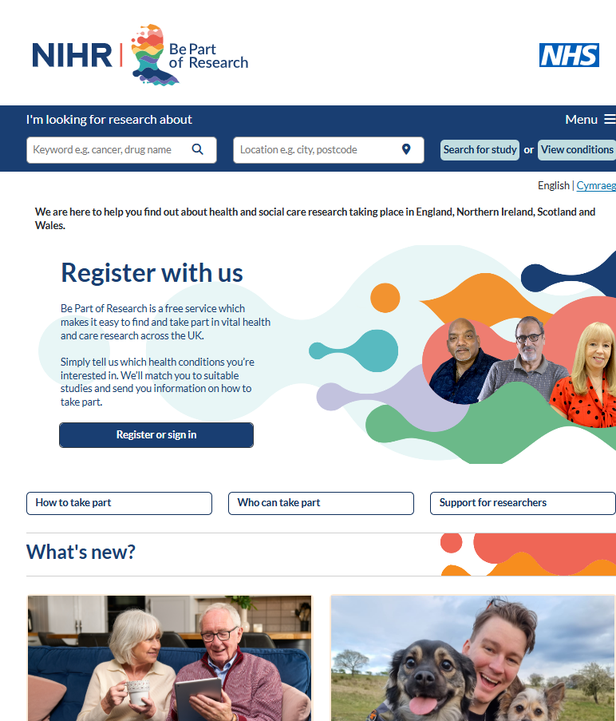


What is Be Part of Research?
A service:
To help the public to learn about taking part in health and social care research
To enable people to search for and find out about studies they can take part in
For the public to register to be contacted about studies into conditions they are interested in
For researchers to recruit volunteers into their studies
Be Part of Research will become an integral service to increase the number of people taking part in research
Carries the NHS logo to demonstrate it is a trusted service for the public
Notes:
What is be part of research be part of research is a service to help members of the public to help members of the public to learn about health and social care research be part of research.
The service has 2 different functions, members of the public can find out what studies are going on and what studies they can take part in and secondly members of the public can be can register to be contacted about research and studies and conditions that they're interested in and also researchers can use the service to recruit volunteers into their studies be part of research is becoming more integral and the front door for members of the public that want to take part in research
It’s for both the public and researchers:
The public can search and register for research opportunities.
Researchers can recruit participants.
It carries the NHS logo, which makes it a trusted and credible source of information.
Ultimately, the aim is to increase participation in research across the UK.

Slide 3
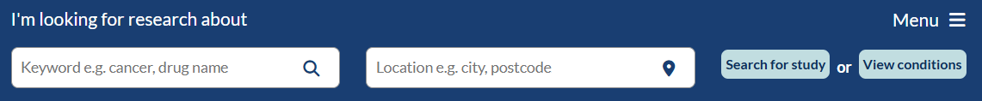
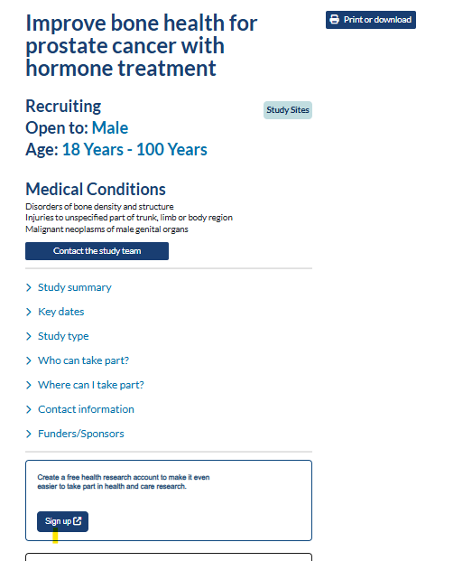
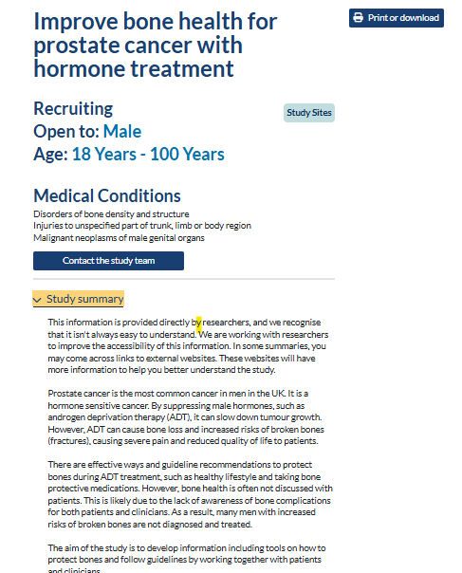
For volunteers: Using study search
Easy to search by condition and/or location
Results can then be filtered as appropriate
Volunteers can then click on a study they’re interested in, read more about it, and use the contact details to follow up further
Notes:
For volunteers wanting to use be part of research they can easily search by condition or by allocation this slide here just shows a screenshot of this members of the public can put in a term and then search and search will come back with all the studies and in that disease area or area of interest and then volunteers can click on the study that they're interested in read more about it and then follow up and with the researcher if they want to

Slide 4

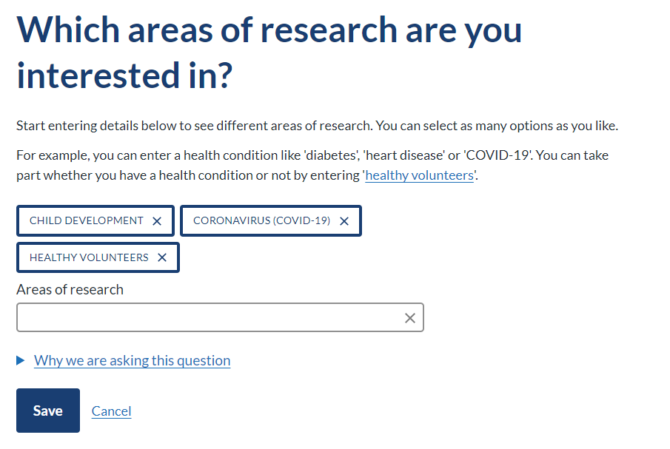
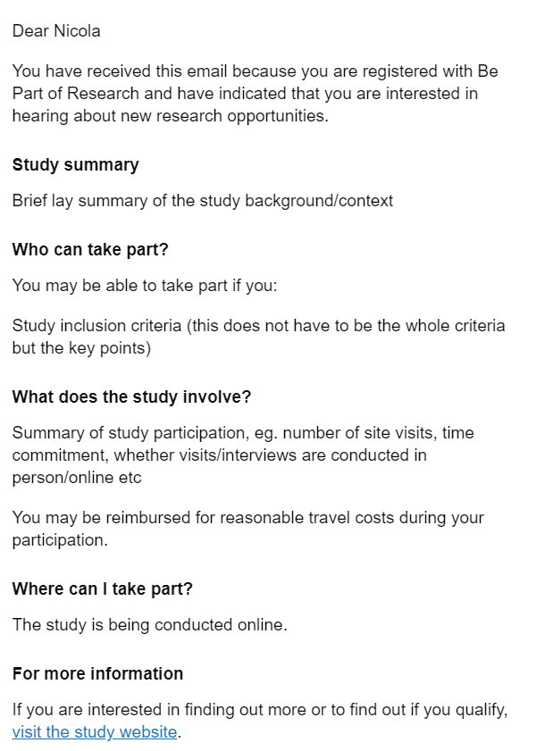
For volunteers: Signing up to and using the registry
Short registration process directly on Be Part of Research website or the NHS App
Volunteers give consent for contact for the areas of research they are interested in and studies of national importance
The Be Part of Research team contact the volunteers by email to signpost them to studies they may be interested in
The email will contain a link to the study’s website, pre-screener or other contact mechanism agreed with the Be Part of Research team
The volunteer then follows the study’s agreed recruitment processes
Notes:
Volunteers wanting to sign up to the Be part of research registry they can do this through a short registration and directly on our website or on the NHS app volunteers are giving consent to be contacted about the areas of interest and they've selected or studies of national importance, the Be part of research team contacts the volunteer and by email and signpost them to studies that they may be interested in based on the areas of interest at the signed up on then the email that sent to the volunteers contains a link to a Study and website maybe a prescreener or another mechanism it might be an email address or a telephone number and this is agreed up front with the Be part of research team and then the Volunteer then follows the agreed recruitment process so be part of research is a bit like the jam in the sandwich you know we're much making putting volunteers that are interested in research in touch with research

Slide 5

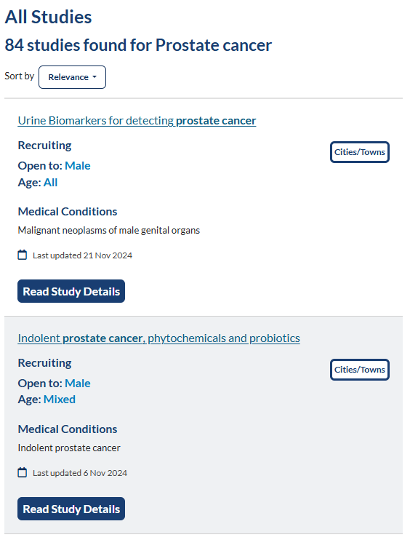
For researchers and study teams: Study search
Study search (condition/location)
Comprehensive, searchable by keyword and location, study list with contact details, including studies across the UK. Studies automatically feed into the site from the following sources and are refreshed each week: ISRCTN ClinicalTrials.gov CPMS (NIHR RDN portfolio non commercial studies)
Notes:
For researchers and studied teams using the study search and it's really important to make sure that researchers know and that they're study potentially will be on be part of research if it's open a comprehensive searchable keyword list is taken automatically from three different feeds on a weekly basis and it's refreshed from isr ctn clinicaltrials.gov and our central portfolio management system cpms for nihr non-commercial portfolio studies just to know commercial studies are taken from clinical trials.gov for commercial sensitivity it's really important to reiterate these the study search comes from three these three different fates not just from cpms and studies have to be open to see it so it gives volunteers a comprehensive view of what studies are going on in the UK not just studies that are on the nihr portfolio

Slide 6
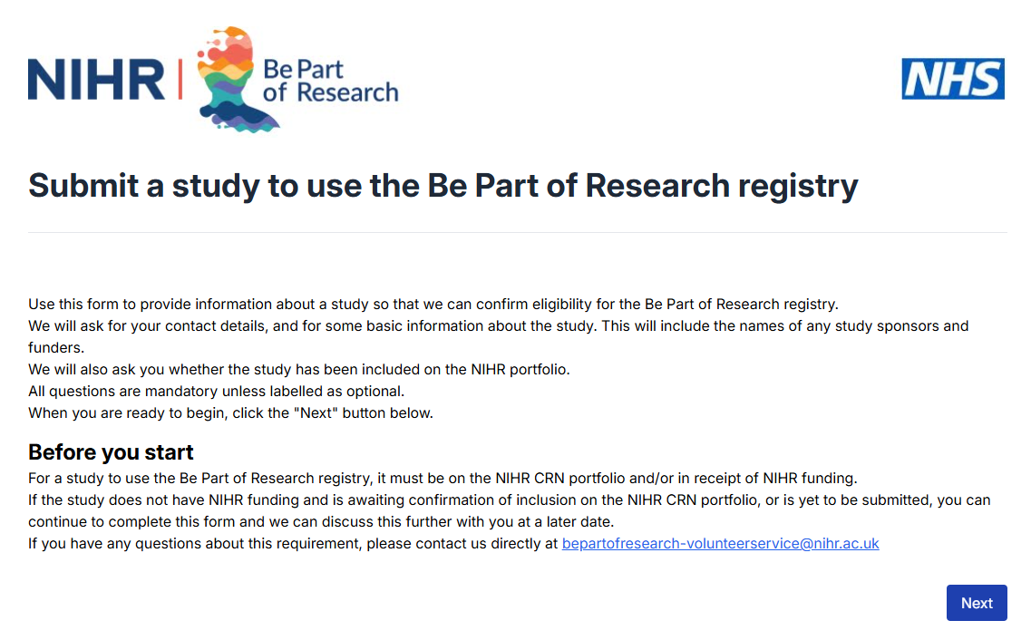
For researchers and study teams: Using the registry
Registry (contact by email service)
Studies listed on the NIHR RDN Portfolio and other NIHR partially or fully funded studies can use this service. Agreement to the service terms and conditions is required. The Be Part of Research team contact the volunteers on behalf of the studies.
Notes:
For researchers and study teams that want to use the registry they're study has to be listed on the RDN portfolio or be partially or fully funded by the nihr to use this service to the service to help recruit to volunteers to research studies. For all NIHR RDN portfolio and NIHR funded studies the researcher / study teams should be thinking of using the free be part of research service.

Slide 7
For researchers and study teams
Free service - can be used as a recruitment tool
A growing number of research-ready volunteers, interested in specific conditions - over 700k people registered
Experienced Be Part of Research team to assist:
contact potential participants by email on behalf of the study
straightforward process, short initial form to complete and template emails available
identify potential participants by condition area of interest, geographic location, date of birth, sex and ethnicity
No additional review required beyond HRA approval
All portfolio and NIHR-funded studies eligible
Service available now and seeking studies
Notes:
So to carry on and for researchers and study teams to use be part of research as a free really important it's a free service as a recruitment tool as mentioned earlier we have a growing number of research ready volunteers that want to take part in research so how it works is the B part of research team will contact potential volunteers by email on behalf of the research study this is straightforward process and researchers study teams complete and initial form which is relatively short and work with the study team to create an email that will be sent to the volunteers and we do have templates that you can use then work with you to determine what and participants you want to recruit to based on your study so what condition What geographical location what age sex and then ethnicity and no additional review is required and beyond hra approval so studies do have to have be part of research mentioned in their ethics submission and we do have the wording for this so please get him touch and as mentioned on a previous slide all portfolio and nihr funded studies are eligible to use the service and we're actively looking for studies at this moment in time and so please do get in touch if you've got a study and that you think would benefit from using the service

Slide 8
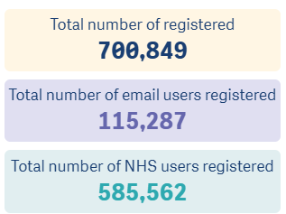
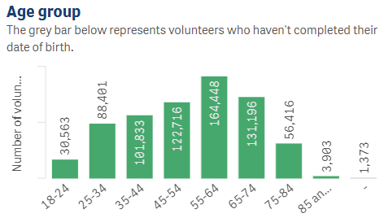
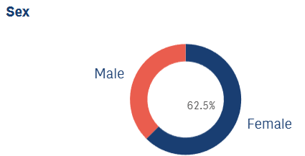
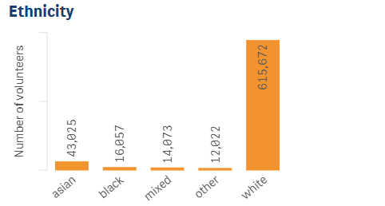
Demographic overview of registered volunteers
Notes:
Dashboard link - https://rdn.uk.qlikcloud.com/sense/app/f1b59209-c0c2-4ad4-9da4-b8489574c74c/hubUrl/%2Finsights%2Fhome
The slide shows the demographics of the volunteers registered on be part of research you can see the age range it's a bell-shaped curve with the majority of people signed our page between 45 and 75 and more females than males on the registry this is representative of a lot of health registries and also so ethnicity we do know that the registry is not representative of census data we know that there is work to do to increase the Asian and black people registered on be part of research it's also interesting to note that the number of volunteers registered have come through the NHS app so more than 4/5 of the Volunteer signed up on to be part of research have signed up using their NHS login and this is because be part of research has periodically been on the front page of the NHS app it still on the NHS app but and you have to look for it

Slide 9
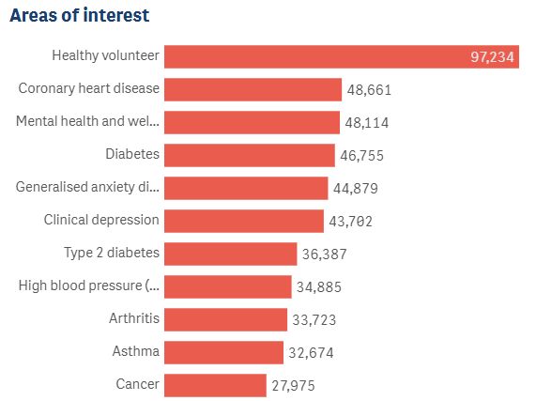
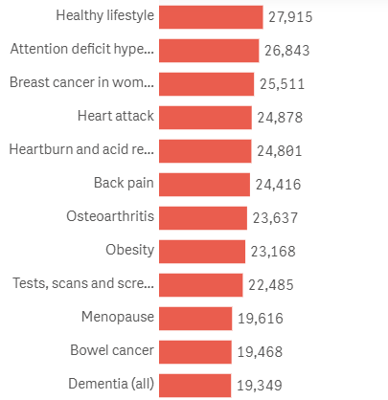
Areas of research specified by registered volunteers

Slide 10
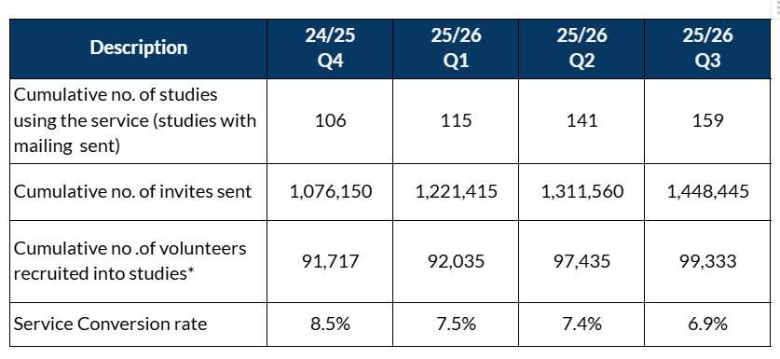
Be Part of Research - studies
21% - Percentage of commercial study recruitment that has come from BPoR for studies on the portfolio using the service.

Slide 11
Other projects /initiatives
GP text messaging - initial pilot with 50+ GP practices across 11 RRDNs . Impact to be reviewed with further expansion if it proves to be successful.
Stakeholder engagement - focus on charities, community groups to boost under-represented volunteer numbers and research companies to increase number and range of studies.
Integration with the NHS app - following commitments made in the NHS 10 Year Plan, discussions are underway with the app team to agree details, roadmap and timeline for this.
BSA project redeveloping BPoR and JDR - planning and groundworks phases complete. Technical development work due to start at end of Sept. Work will be ongoing throughout next year and into 2027.

Slide 12
Advancing health research together
With your help, research can go further and faster:
Help us to promote Be Part of Research across your channels, to any colleagues and to any service users you support.
Recommend Be Part of Research to your researcher communities as a tool to support study recruitment
Encourage them to register their study
Encourage using BPoR as registry of choice for volunteers
Help us to meet our strategic objectives and make research easy to access for all.
Notes:
So with your help research can go further and faster so please can you help us to promote be part of research across your channels when you're speaking about research recommend be part of research to your research community as a tool to support ready and study recruitment and encourage them to be on the register to use the register and ultimately this will help us meet our strategic objectives and make research easier for everybody

Slide 13
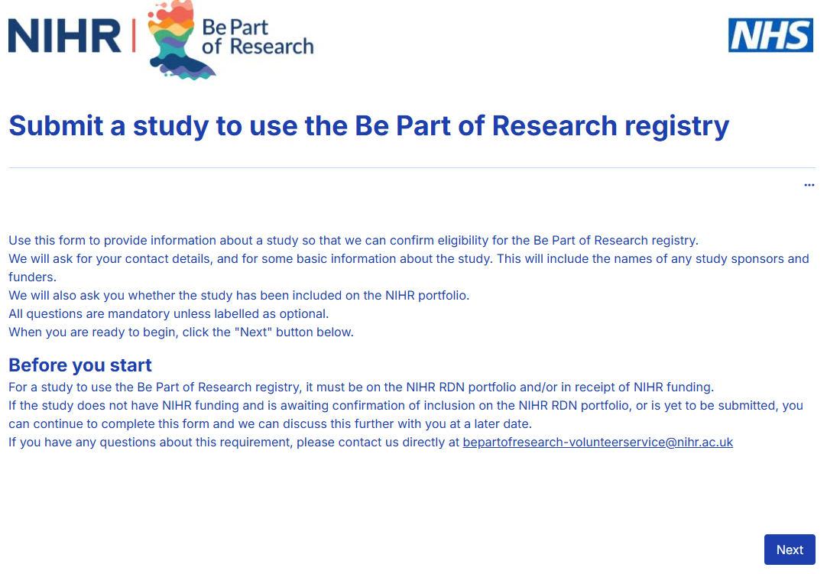
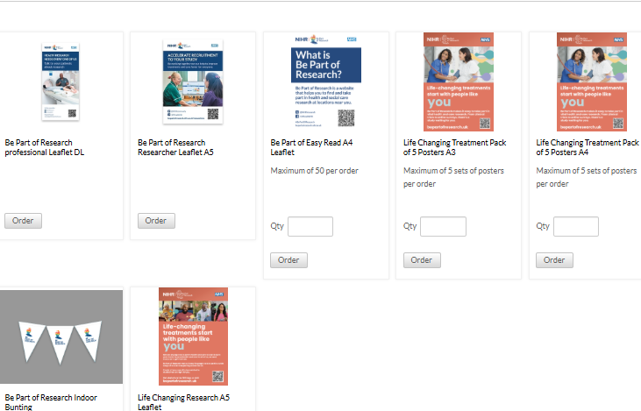
Useful resources / links:
Information for researchers site page: https://bepartofresearch.nihr.ac.uk/researchers-and-health-and-care-professionals/information-for-researchers/
Be Part of Research Study Registration study form: https://app.onlinesurveys.jisc.ac.uk/s/leeds/be-part-of-research-registry-study-registration-form
How to order materials, posters etc: Resources and materials - Be Part of Research
Notes:
The slide show some useful resources and links for you to use a link to the researchers page on our website and a direct link to the study registration form and also a link to how to order materials flyers etc that can be used in your facilities so in GP surgeries given out events etc and these are all free to order

Slide 14
Thank you for listening
Contact details - ashley.minchin@nihr.ac.uk

